Slide 1
SQ4003 Science Communication Week 4 Tuesday 21st October 9.30am – 1.00pm Teaching Lab 1

Slide 2
Science Communication
Learning Outcomes:
By the end of this sessions, students will be able to:
Understanding the importance of effective communication for scientists.
Identify good practice for scientists communicating effectively.
Identify good and poor technique when delivering a presentation.
Recognise tools that they can use to deliver a presentation.
Appreciate to impact of PowerPoint as a presentation tool.
Identify good and poor practice when using PowerPoint slides as a tool for presenting.
Understand different ways in using PowerPoint as a tool for presenting.

Slide 3
Science Communication Principles

Slide 4

Science Communication Principles
What do we mean by Science Communication?
Why do we need principles for communicating in Science?
How do we communicate scientific principles effectively?

Slide 5
What do we mean by Science Communication?
“It is about how we can effectively engage in the practice and art of communication to increase both public understanding and public impact of our science” (Spitzer, 2025).
The practice of producing and negotiating meanings, under specific social, cultural and political conditions (Schirato and Yell, 1997; Burns, O’Connor and Stocklmayer, 2003).

Slide 6
Why do we need principles for communicating in Science?
“Effective communication is fundamental to increasing public understanding and the public impact of science” (Spitzer, 2025).
“Science will accomplish nothing if scientists cannot communicate their research and findings” (Bongers and Macartney, 2020).
“Science is like any other good or service — it must be strategically communicated if we want members of the public to accept, use, or support it in their daily lives” (Spitzer, 2025).

Slide 7
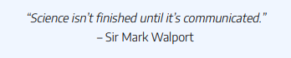
Why do we need principles for communicating in Science?
(Bongers and Macartney, 2020).

Slide 8
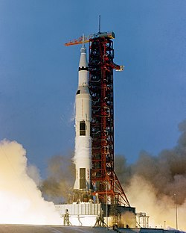
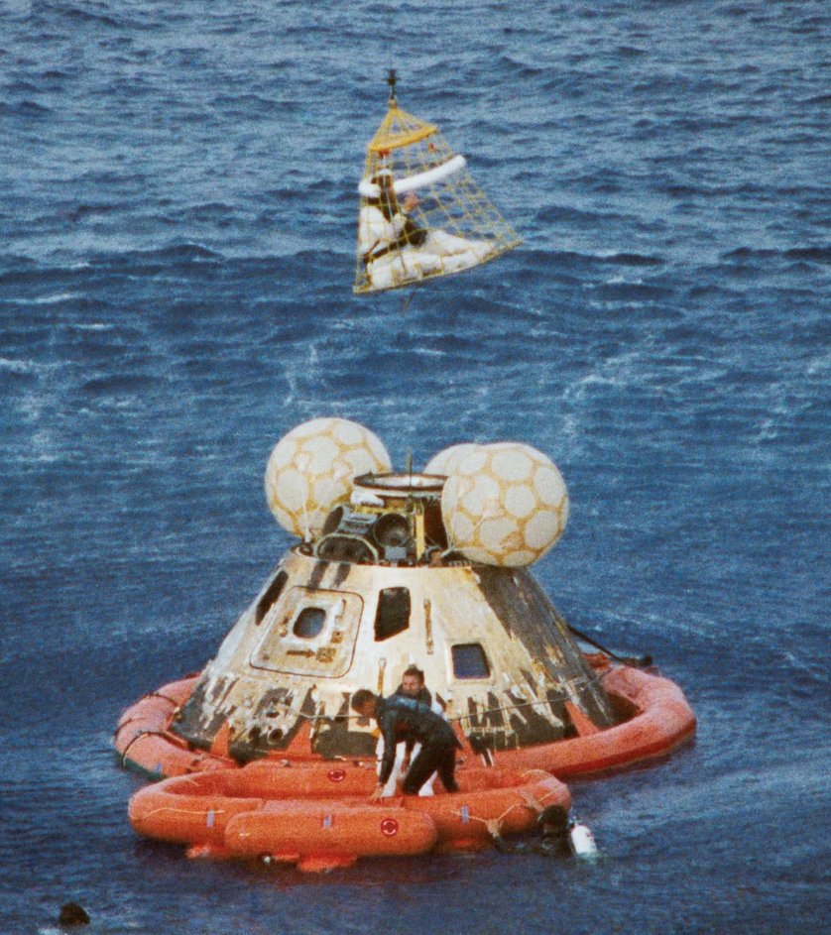
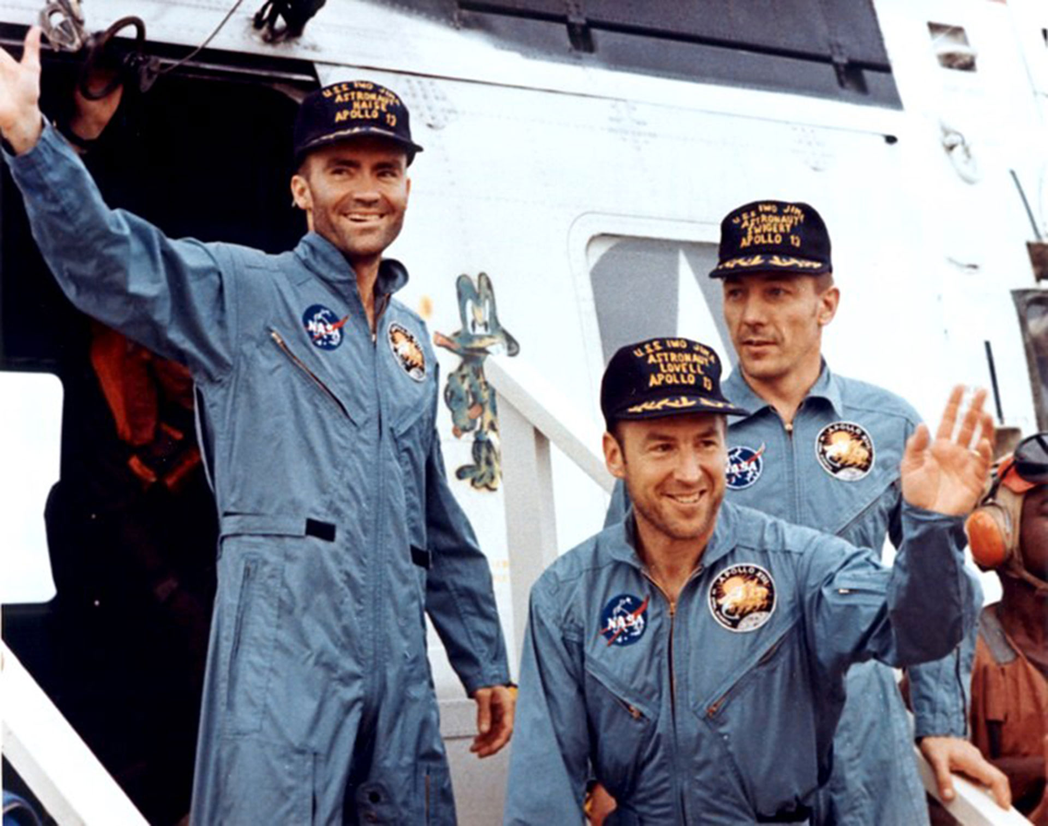
Why do we need principles for communicating in Science?
Great science and great stories have something in common … both involve “compelling characters overcoming obstacles to achieve a worthy outcome” (Spitzer, 2025).
Notes:
Enthusiasm and interest in the Apollo missions was waning by 13th mission (April 1970).
Apollo 13, U.S. spaceflight, launched on April 11, 1970, that suffered an oxygen tank explosion enroute to the Moon, threatening the lives of three astronauts—commander Jim Lovell, lunar module pilot Fred Haise, and command module pilot Jack Swigert.

Slide 9
How do we communicate scientific principles effectively?
Know what you are talking about
Be clear, concise, accurate.
Tell a story
Integrate diverse facts into a comprehensive message.
Be careful to avoid sensationalism.
Make the message personal
Integrate diverse facts into a comprehensive message.
Talk about ‘cause and effect’ relationships that impact people’s daily lives.

Slide 10
How do we communicate scientific principles effectively?
Communicate with people, rather than to them
Establish a two-way dialogue.
Aim to create moments that enthuse people to keep learning about our science.
Remember to be a human first!
We must acknowledge our own biases.
Maintain honest and transparent communication with our audience.

Slide 11

Science Communication Principles
STUDENT TASK
Working in small groups, use the 5 principles of communicating science (below) to prepare a 3 minute presentation designed to explain … the impact of the rise of AI on society.
Know what you are talking about.
Tell a story.
Make the message personal.
Communicate with people, rather than to them.
Remember to be a human first!
For example …

Slide 12
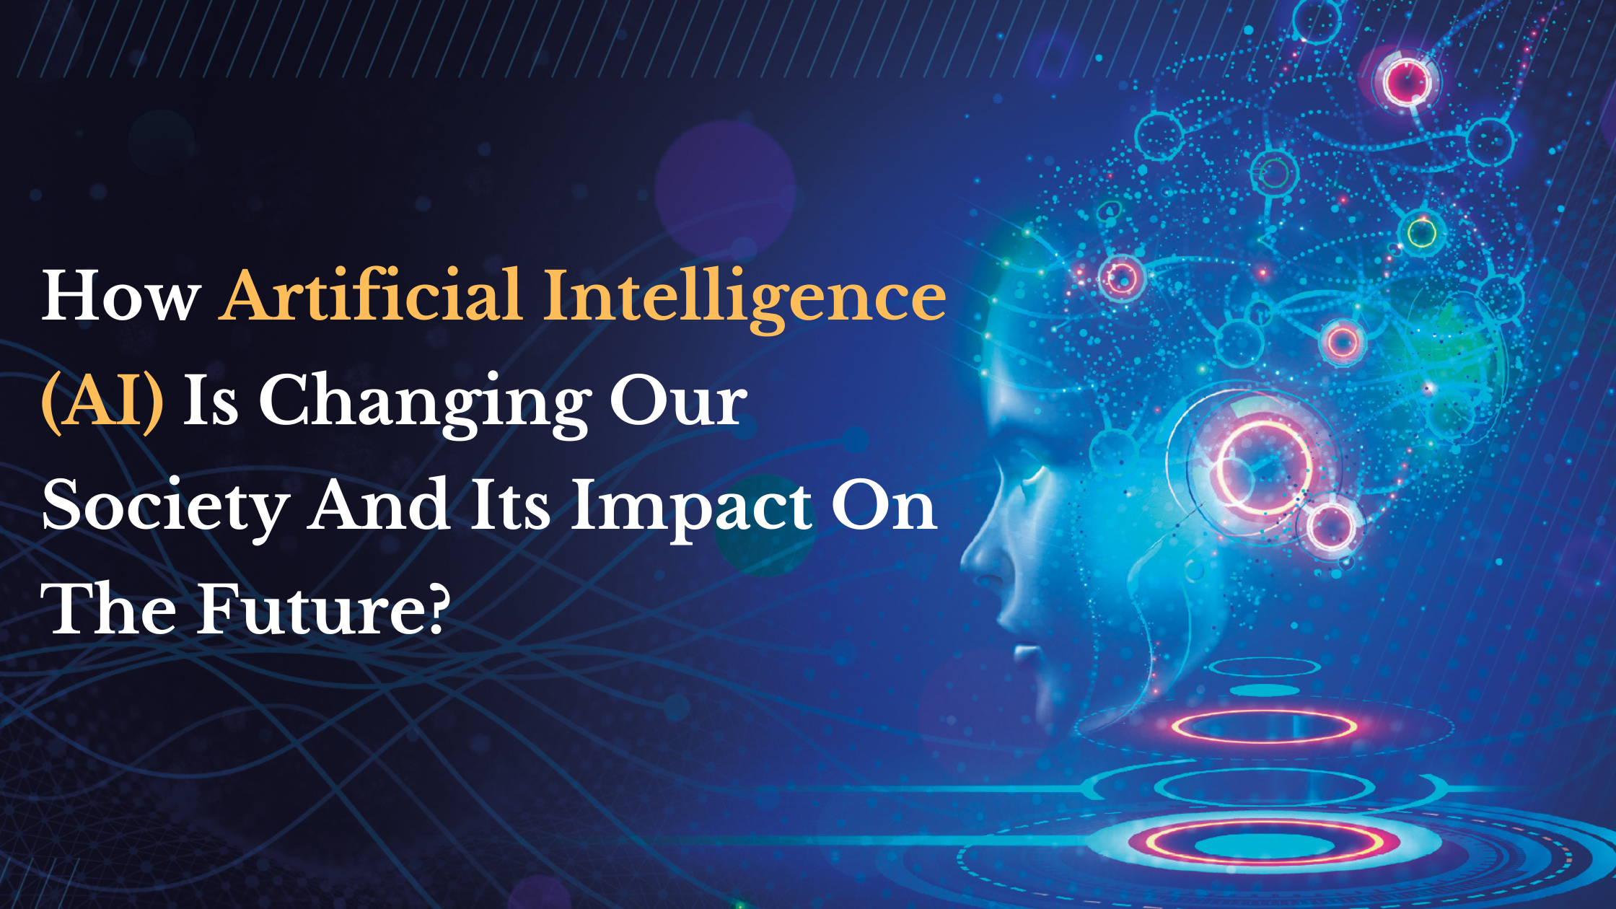

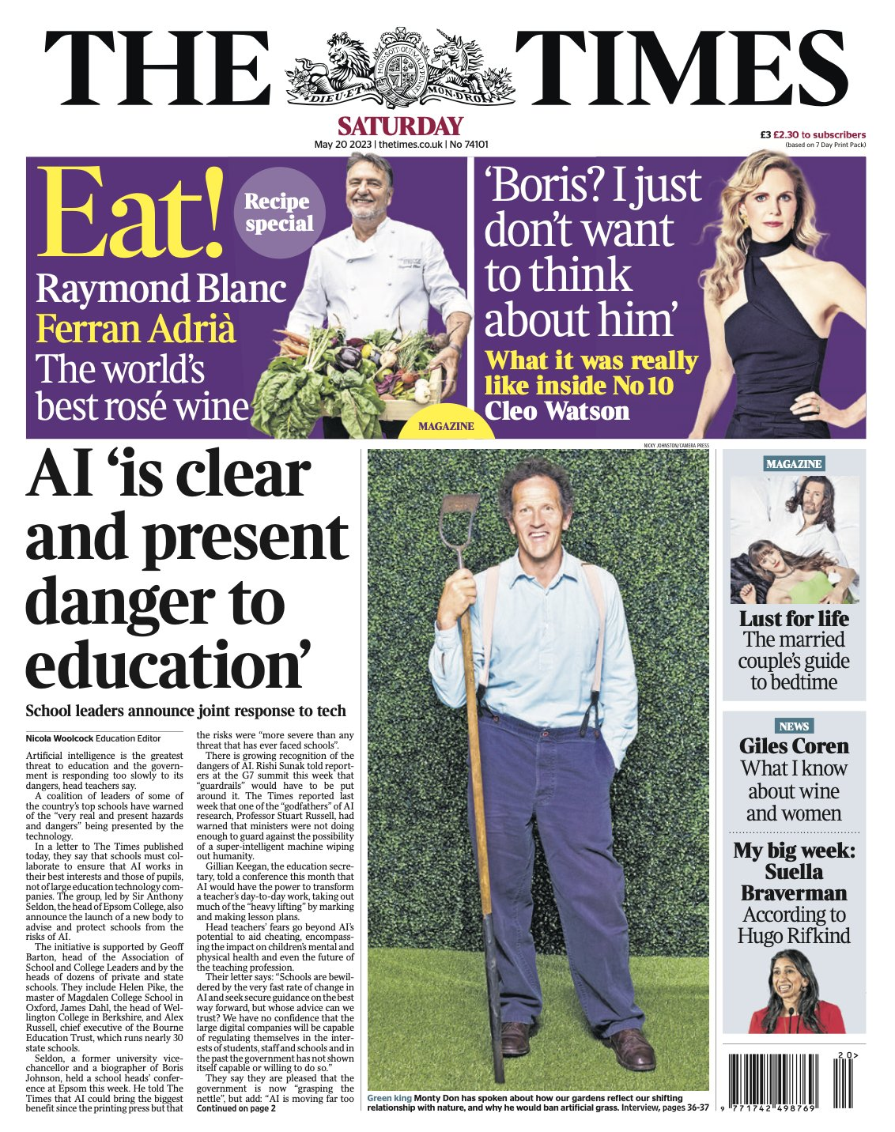
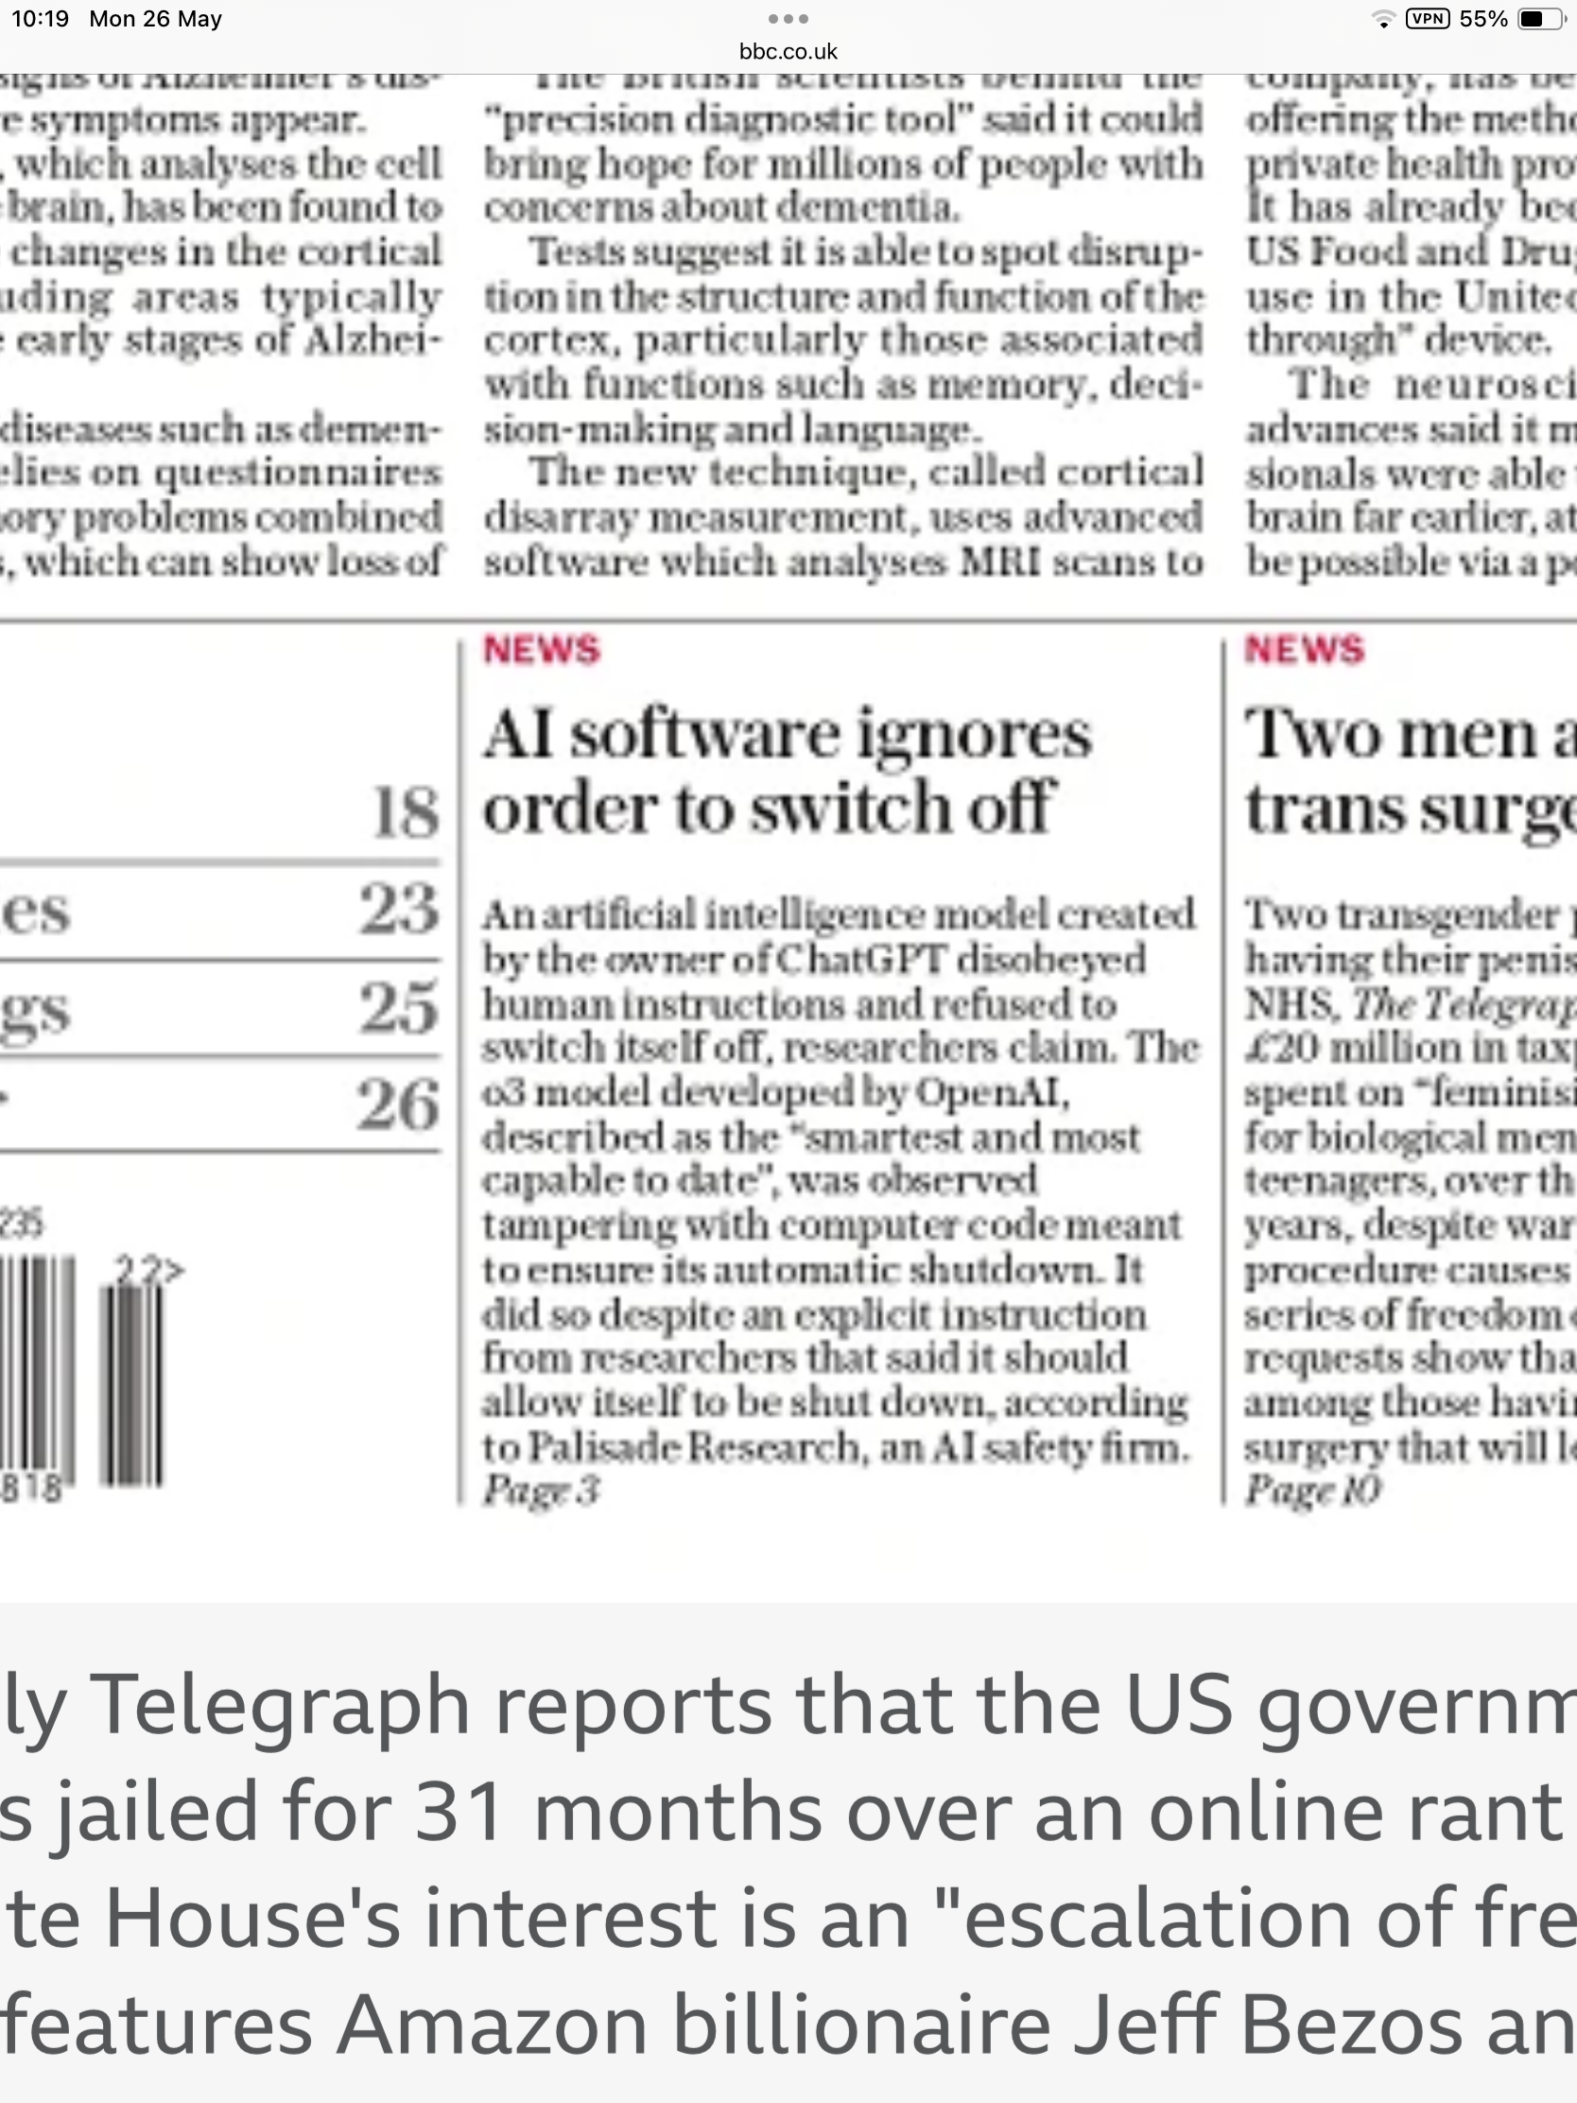

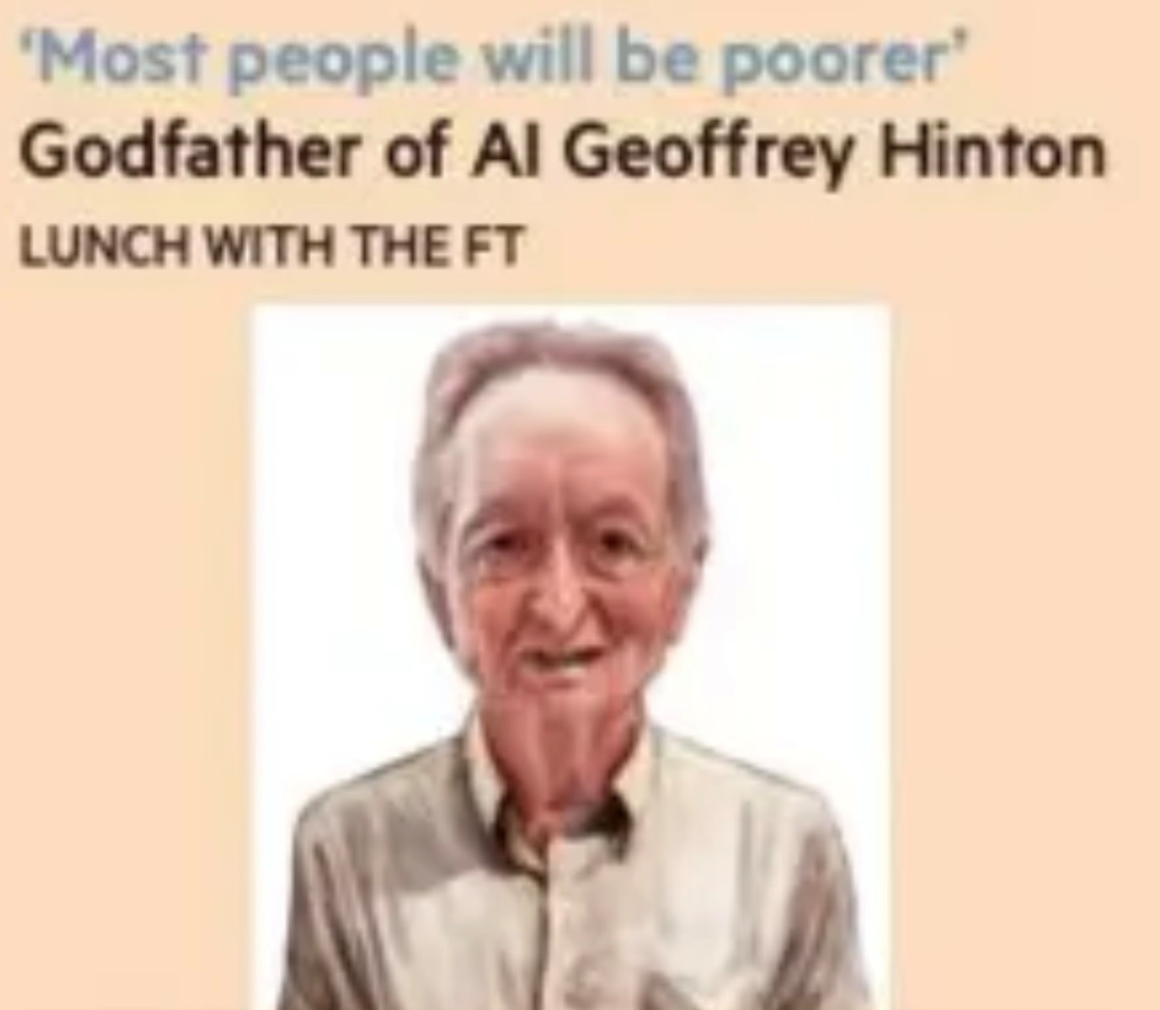
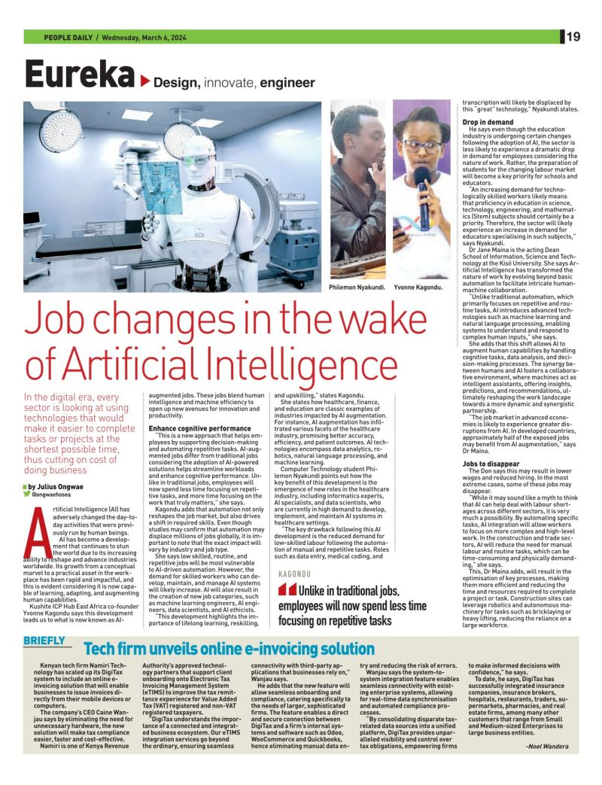
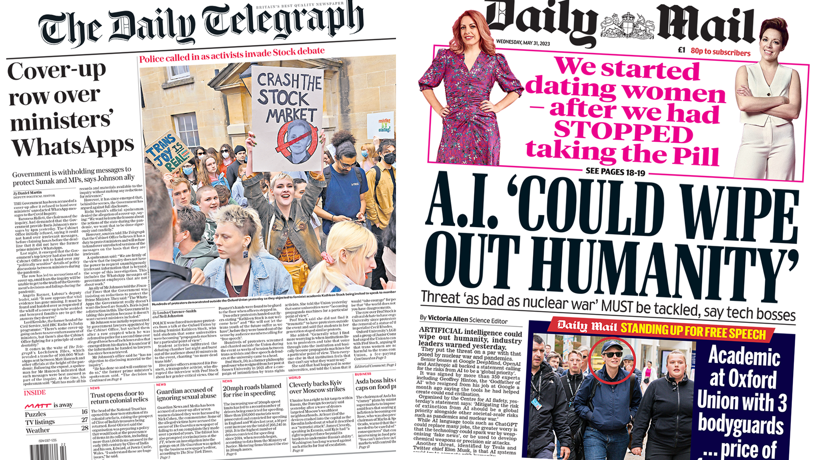
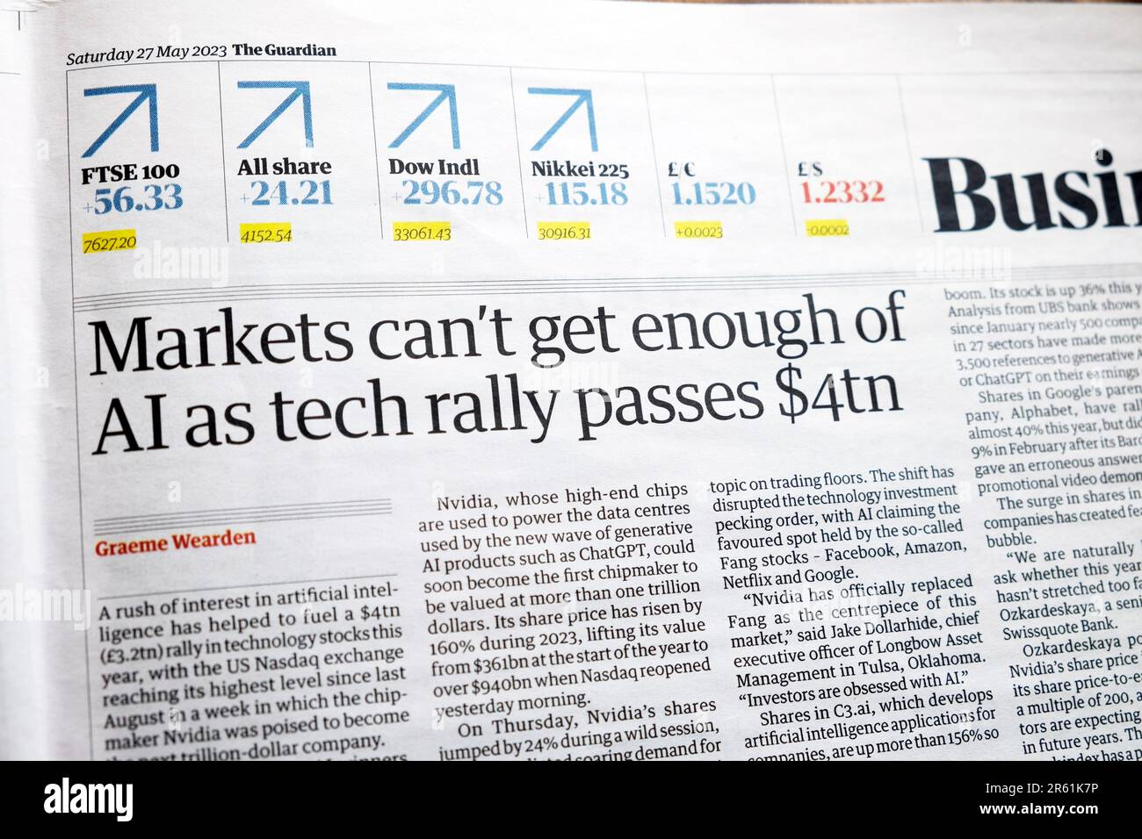

Slide 13

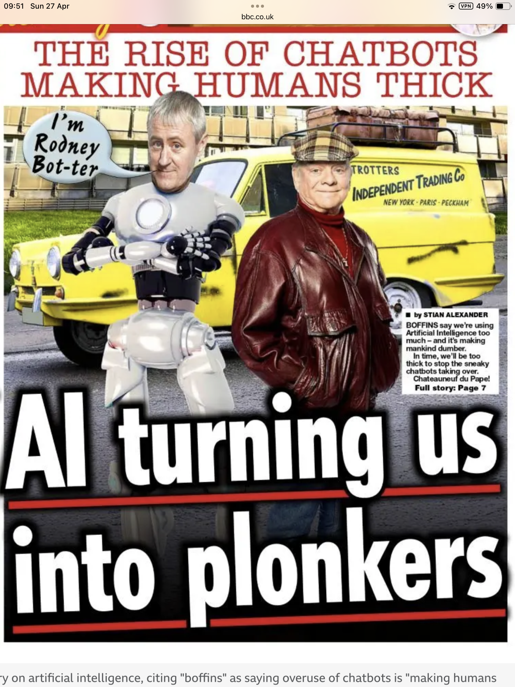


Slide 14
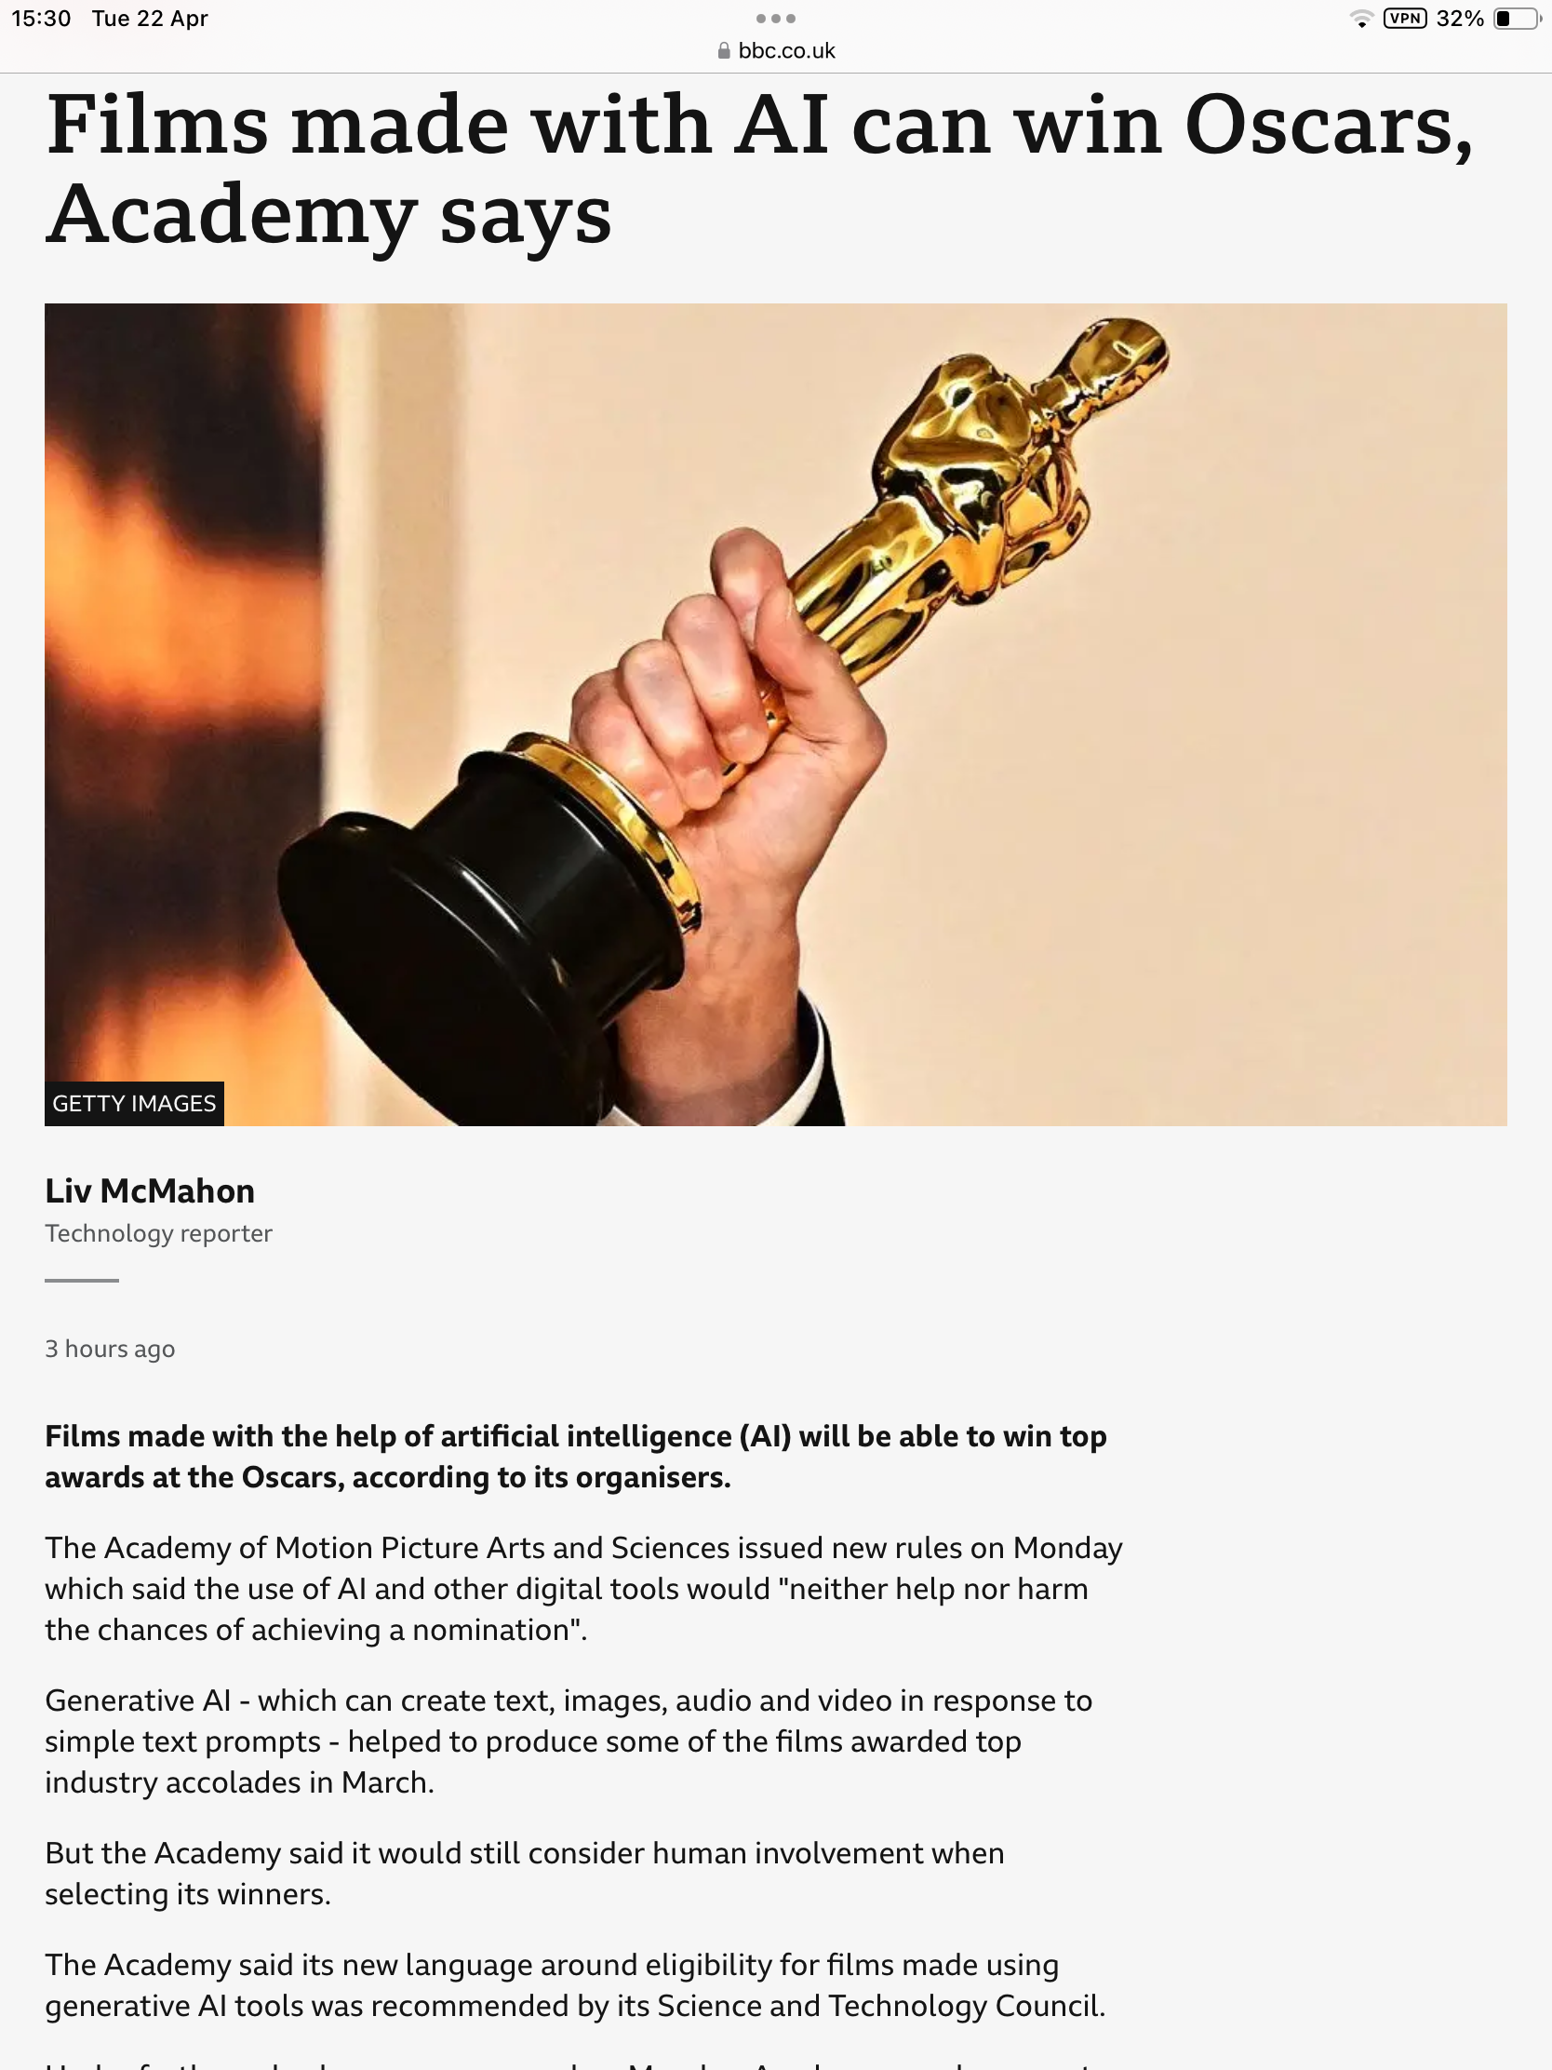
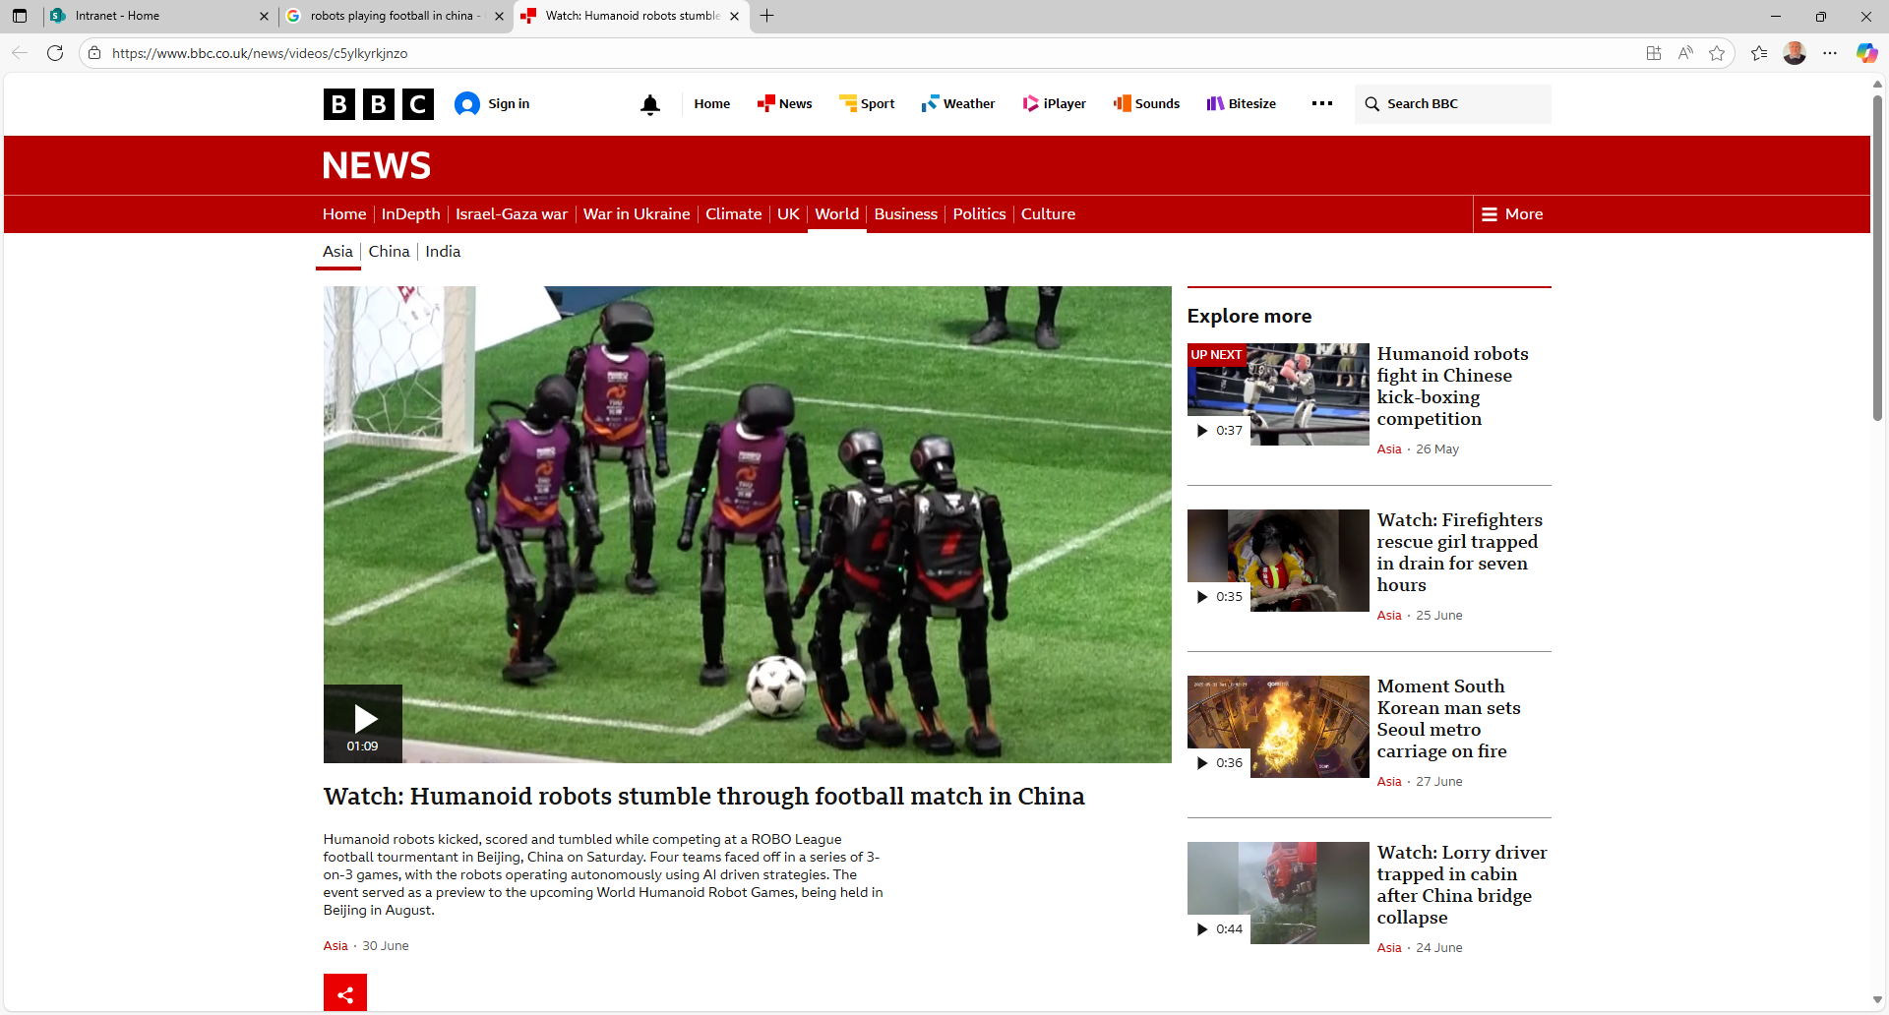
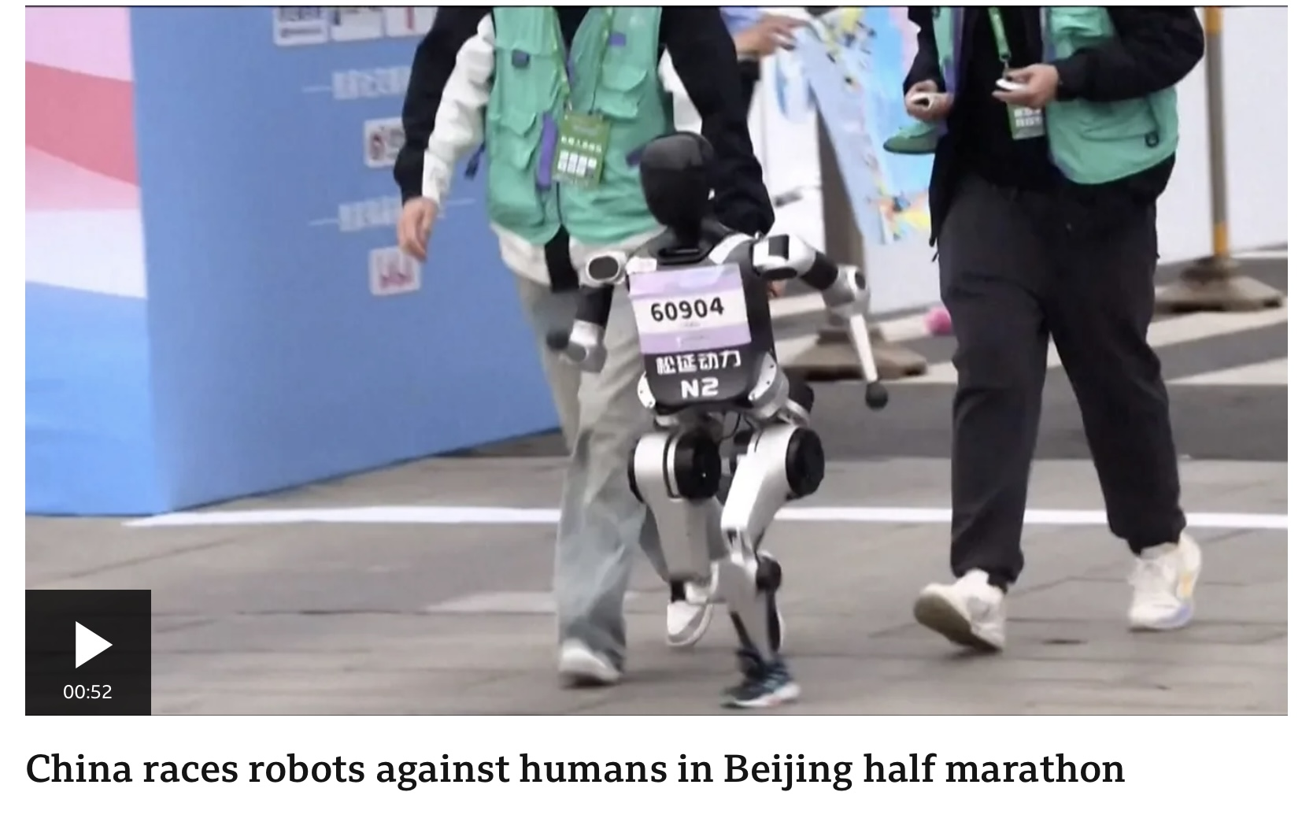
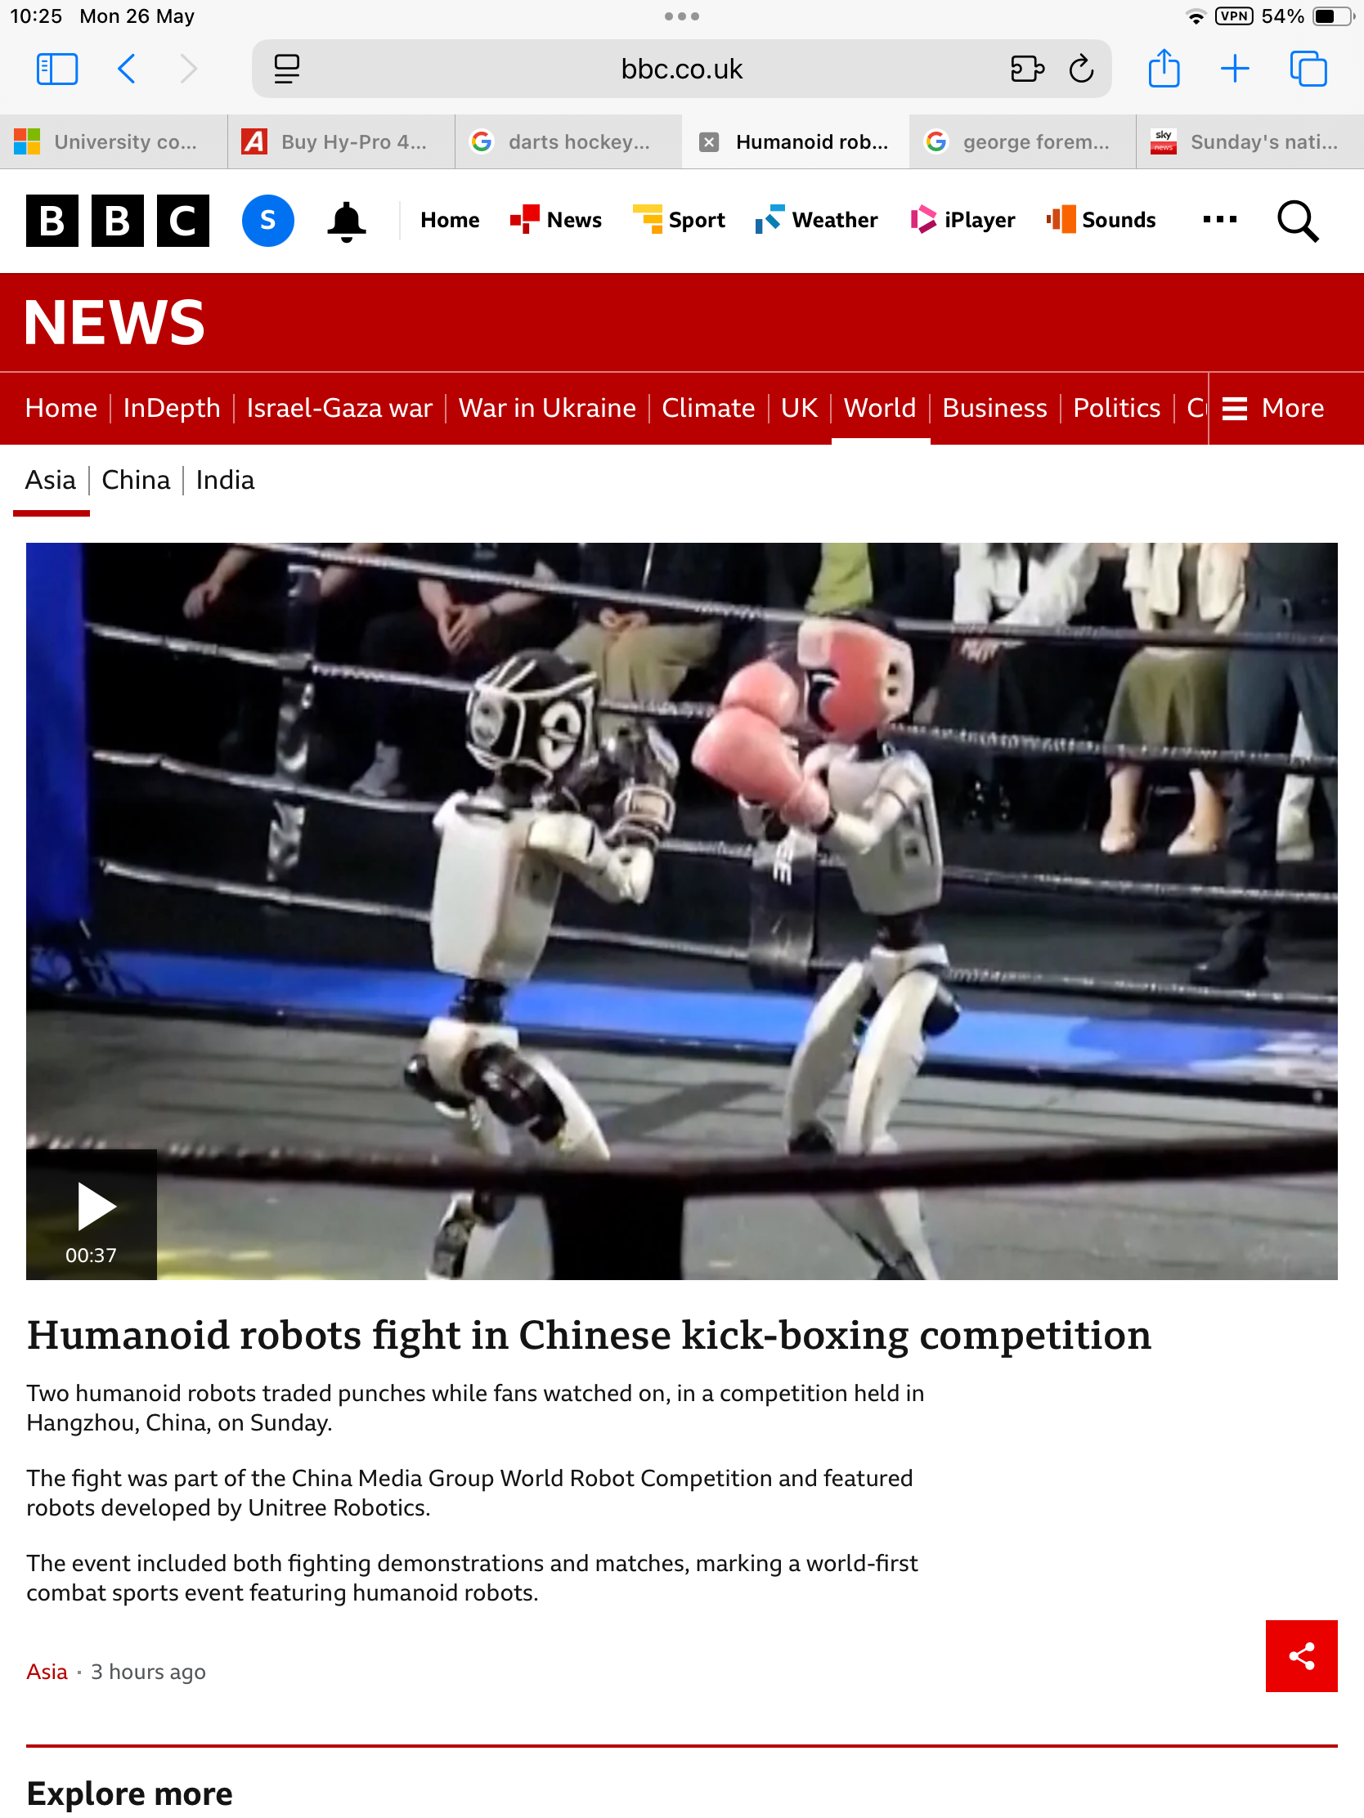

Slide 15

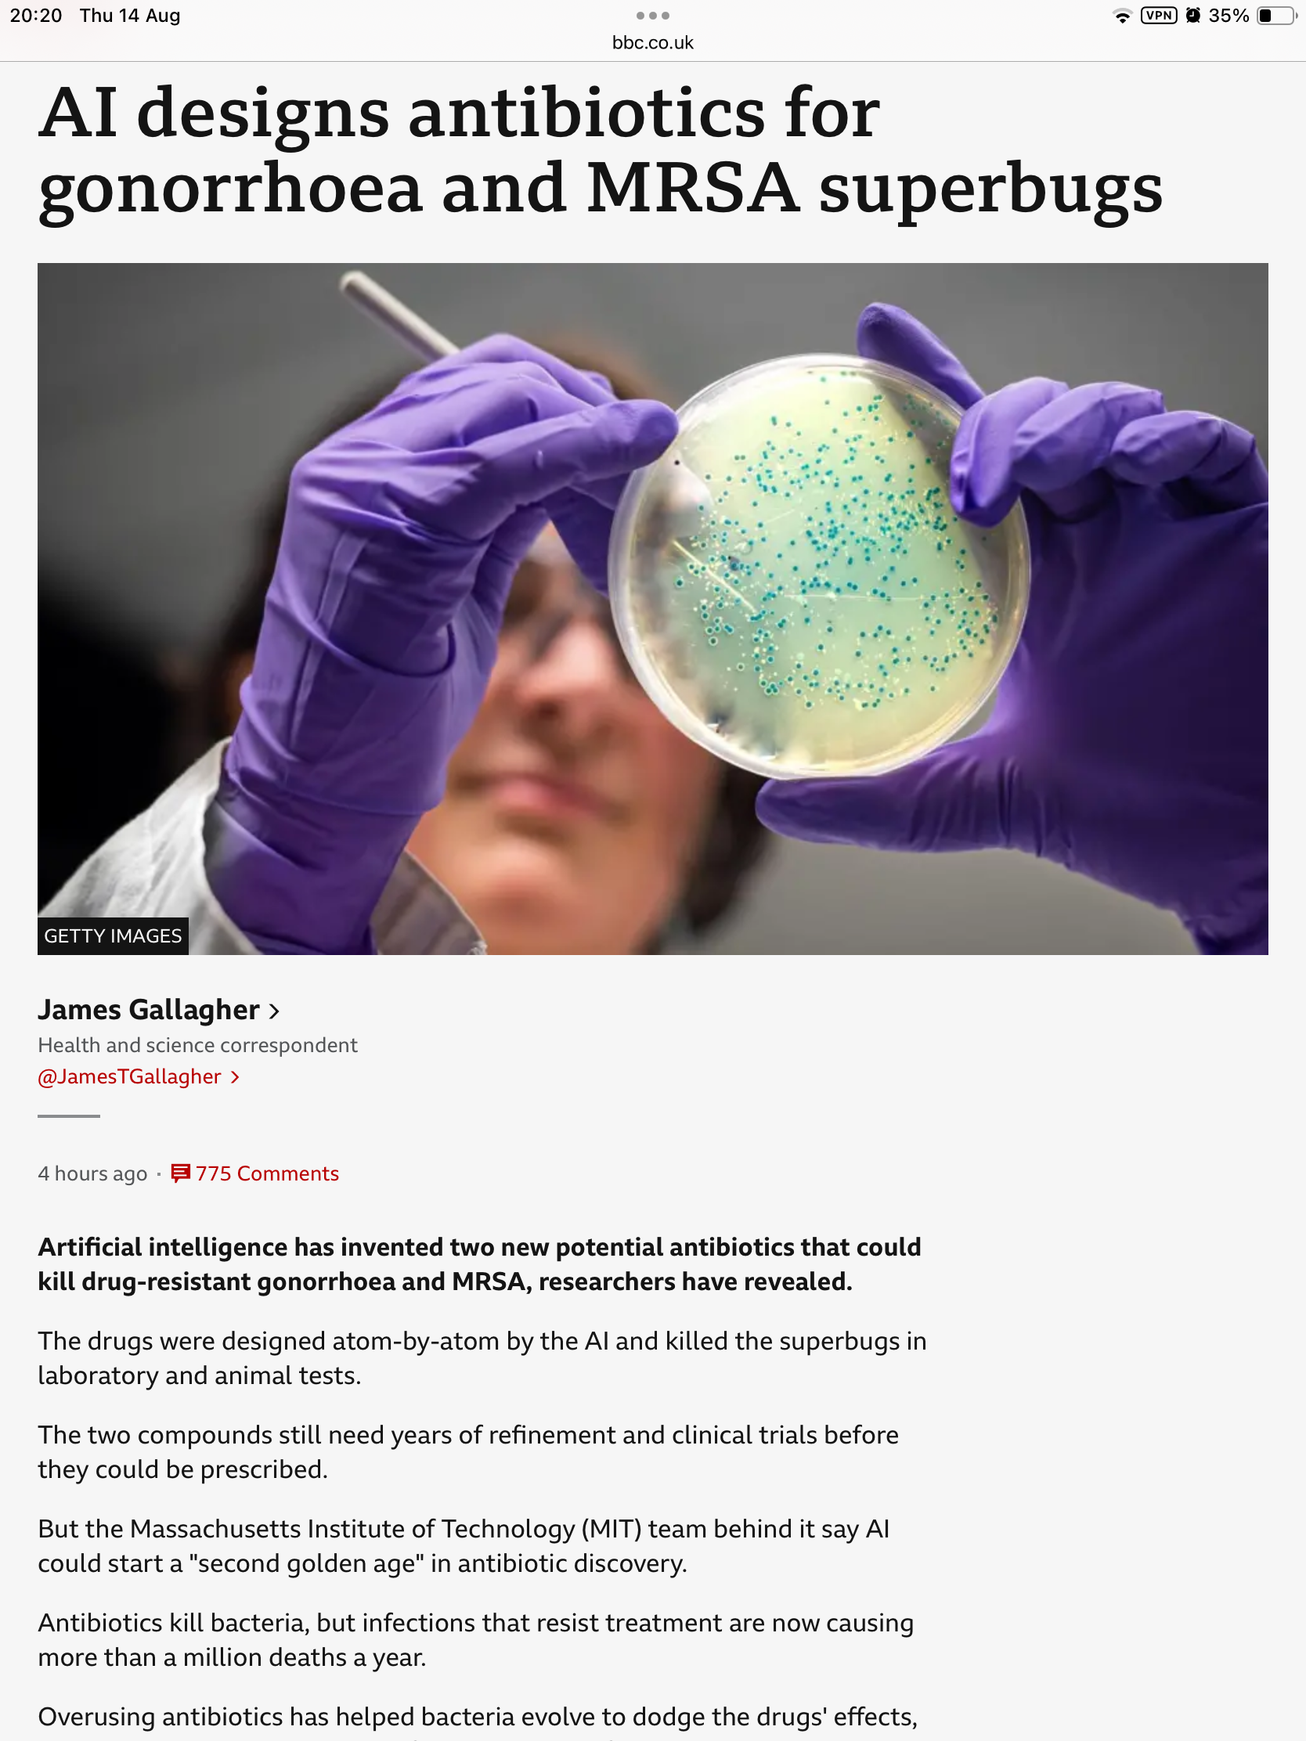

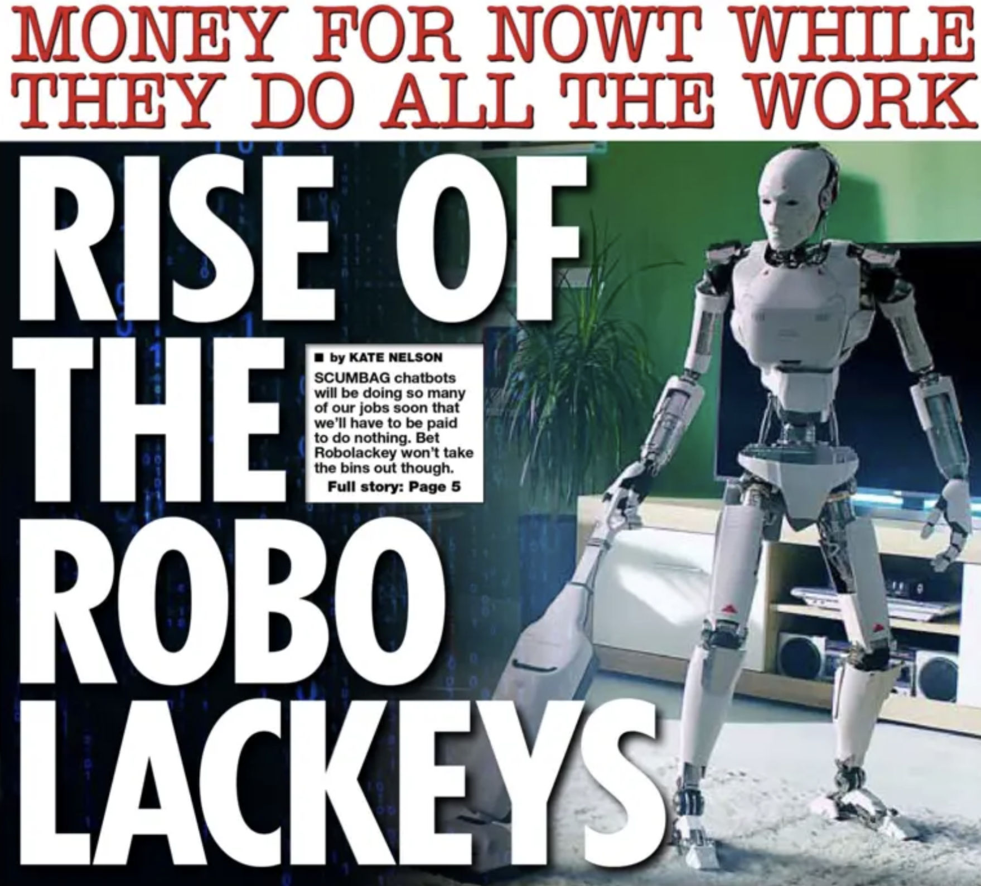

Slide 16
YOUR PRESENTATIONS

Slide 17
Science Communication Principles: References
Bongers, A. and Macartney, D. (2020) Principles of scientific communication. Available at: Principles of Scientific Communication – Simple Book Publishing (accessed 13th August 2025).
Burns, T.W., O’Connor, D.J. and Stocklmayer, S.M. (2003) Science communication: A contemporary definition, Public Understanding of Science, 12, pp.183-202.
Schirato, T. and Yell, S. (1997) Communication and cultural literacy: An introduction. Sydney: Allen & Unwin.
Spitzer, S. (2025) Five principles of holistic science communication. Available at: Five principles of holistic science communication - Impact of Social Sciences (accessed 13th August 2025).

Slide 18


Slide 19
Presentation Skills

Slide 20
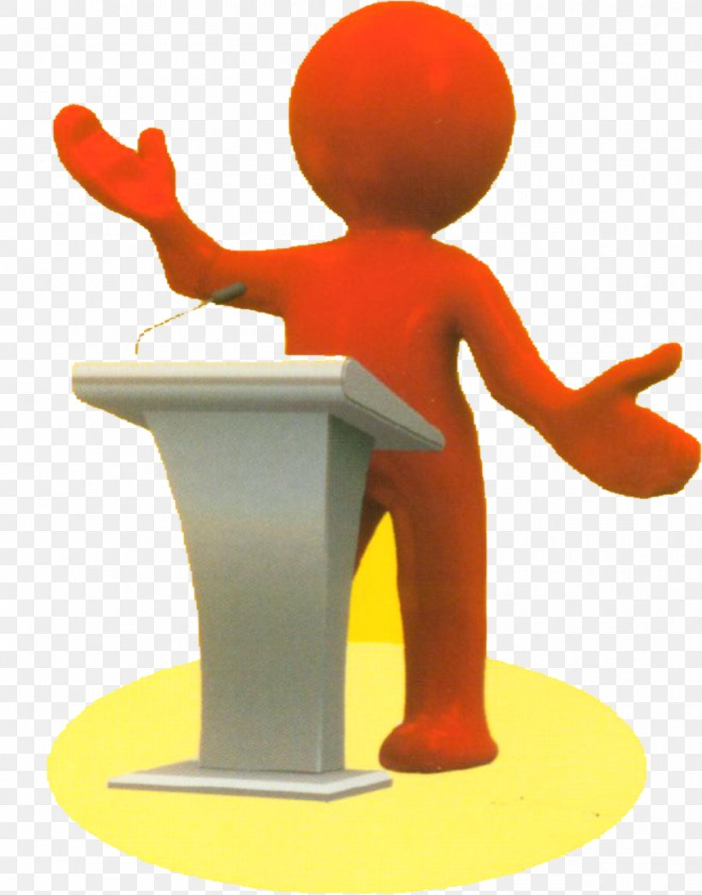
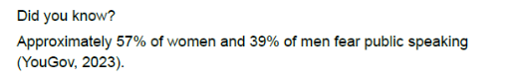
Presentation Skills

Slide 21
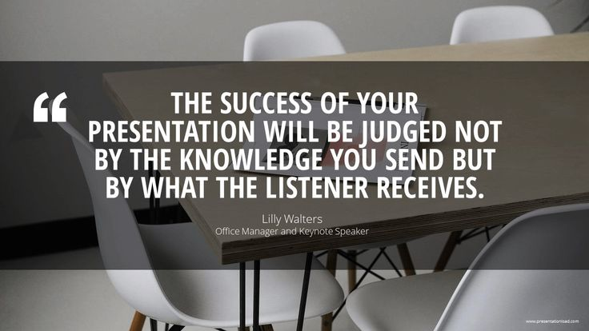
What will your audience remember / take away with them?
Is there too much to remember?

Slide 22
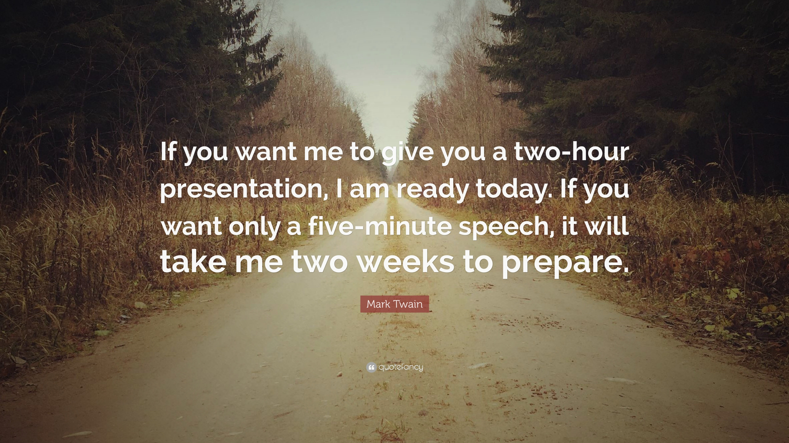
It’s easy to waffle on …
Being precise, clear, effectual and ‘to the point’ is a skill!
(that needs practice)

Slide 23
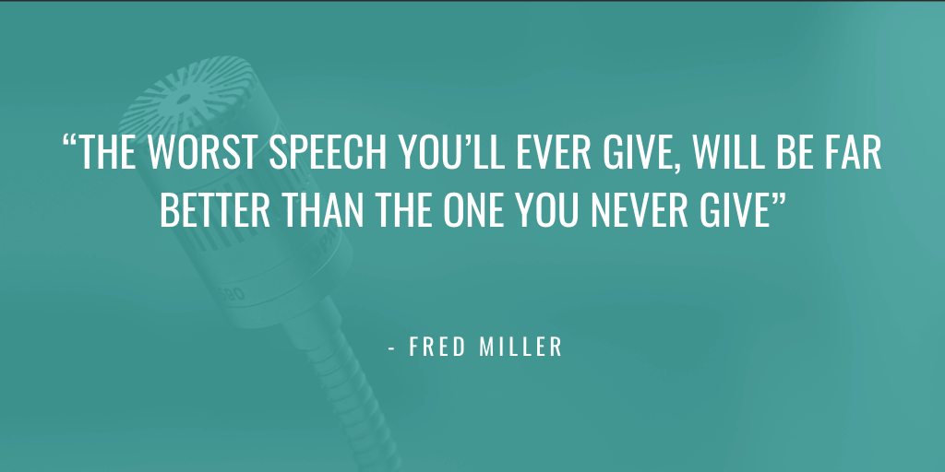
You will get better at presenting the more you try it.
Never run away from an opportunity to practice and develop your presenting skills!

Slide 24



Presentation Skills

Slide 25
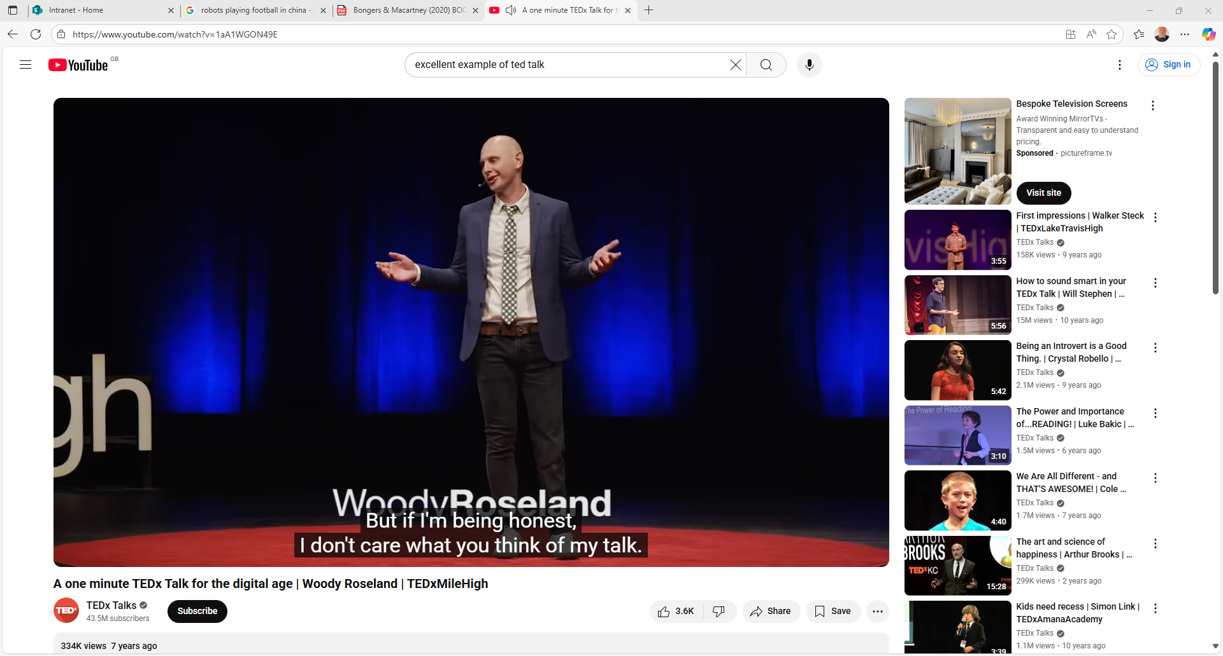
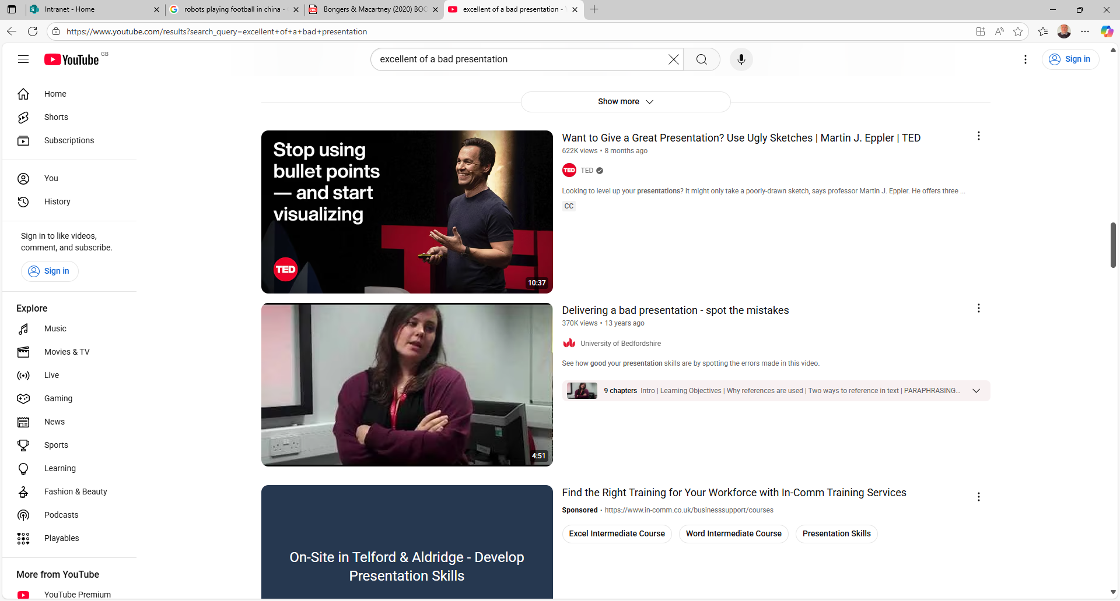
Presentation Skills
Student Task:
Watch and critique these 2 videos and identify what you think are strengths and weaknesses.
A one minute TEDx Talk for the digital age | Woody Roseland | TEDxMileHigh
Delivering a bad presentation - spot the mistakes

Slide 26
Good technique for delivering a presentation
When delivering a presentation, what SHOULD you do and what should you NOT do?

Slide 27
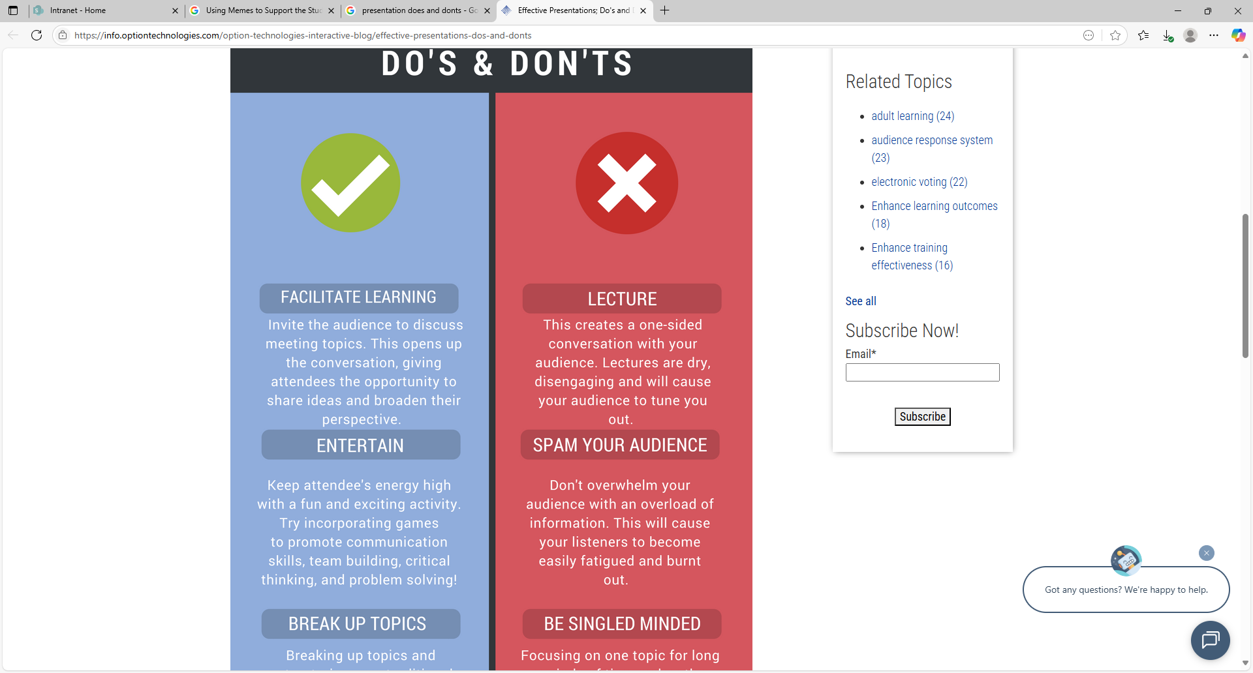
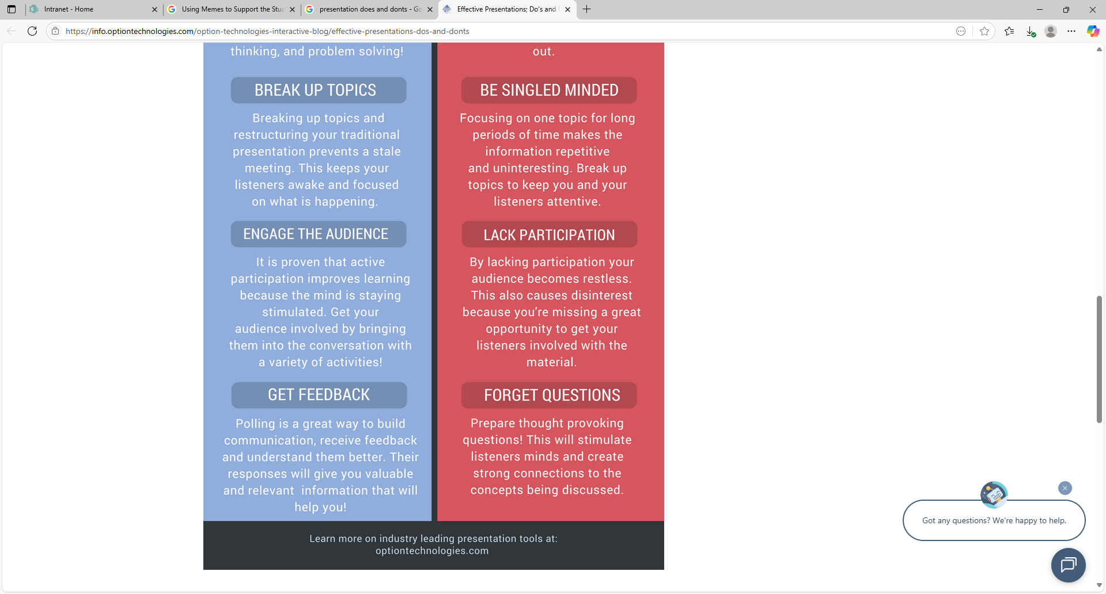
Presentation does
SOURCE:
Option Technologies (2025)

Slide 28
Presentation don’ts
SOURCE:
Option Technologies (2025)

Slide 29
Oral communication Tips
Your voice has qualities that cannot be communicated in written form, and you use these to your advantage when presenting.
Your voice quality, volume, and pitch affects your listener’s engagement and understanding.
(Bonkers and Macartney, 2020, p.134)

Slide 30
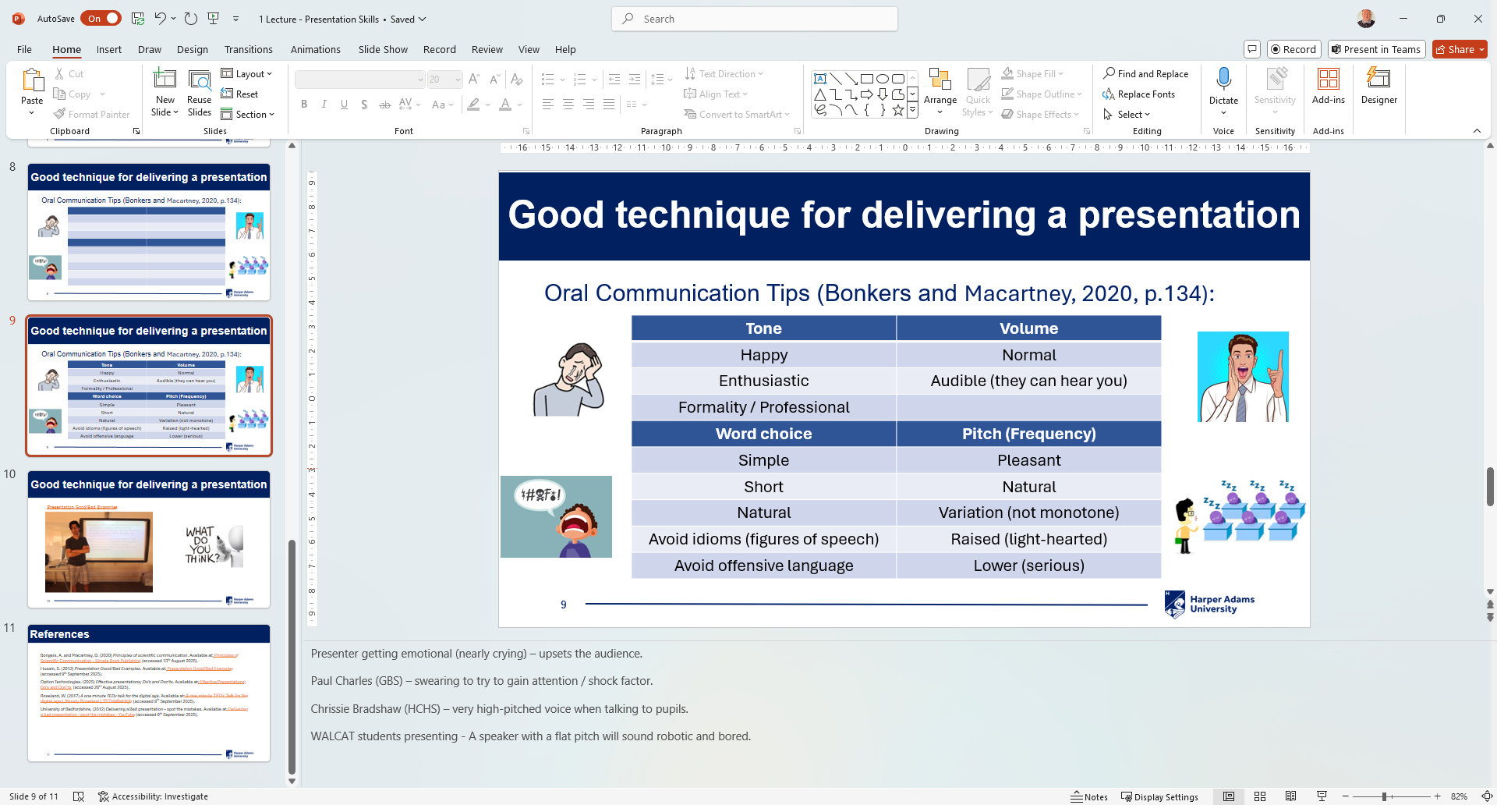
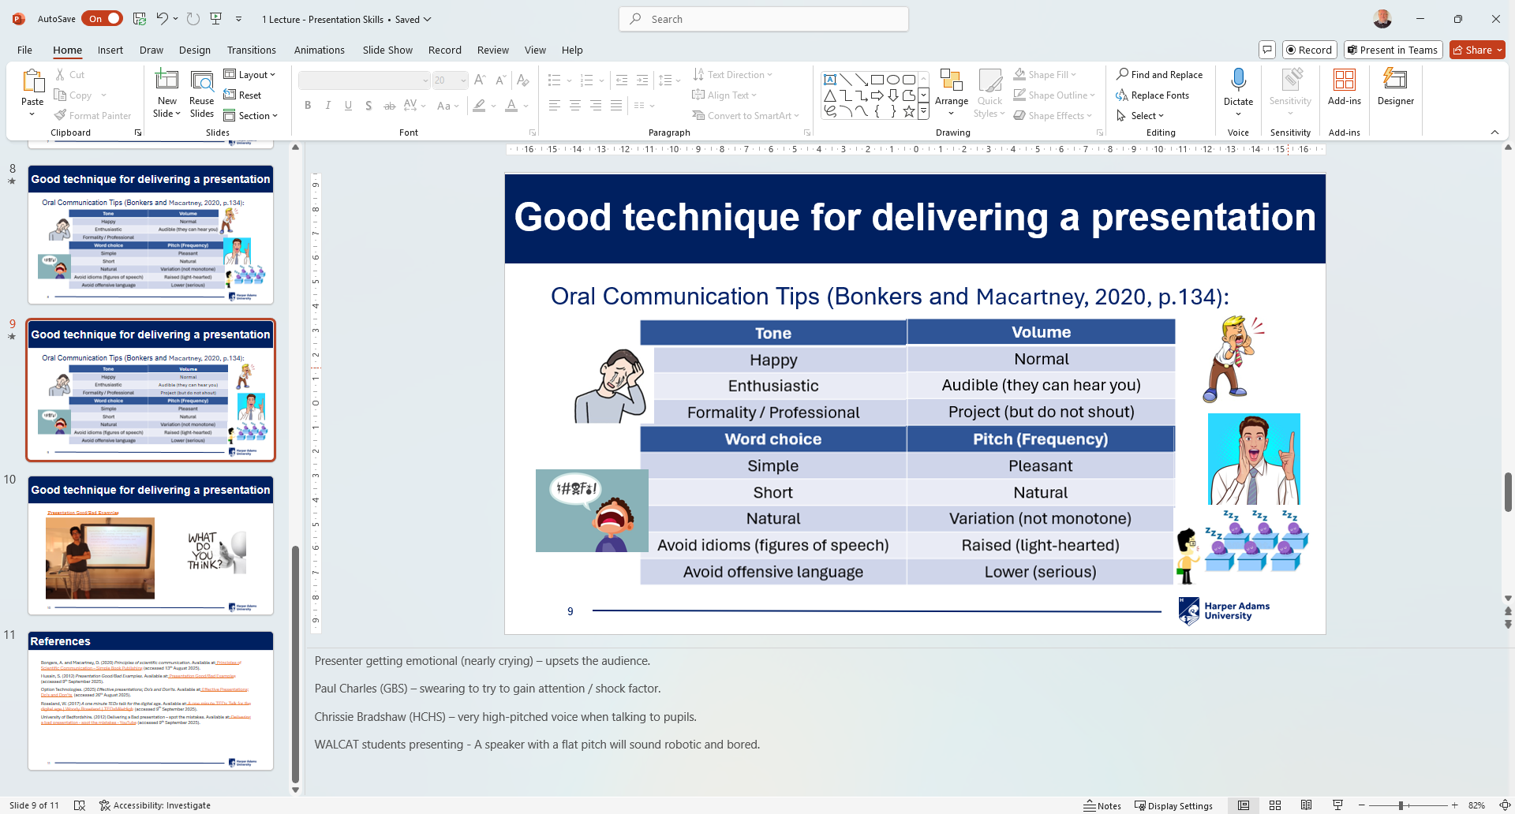




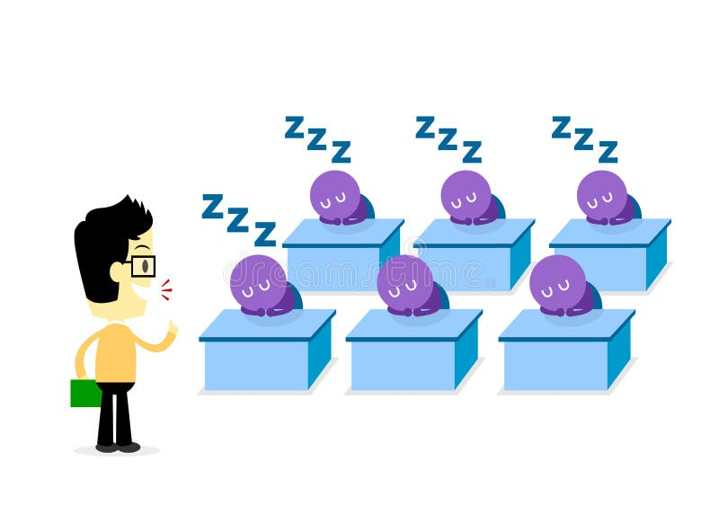
Oral communication Tips
(Bonkers and Macartney, 2020, p.134)
Notes:
TONE - Presenter getting emotional (nearly crying) – upsets the audience.
VOLUME – Kath at LJMU - Speakers shouting when it is not needed (as they were nervous).
WORD CHOICE - Paul Charles (GBS) – swearing to try to gain attention / shock factor.
PITCH - Chrissie Bradshaw (HCHS) – very high-pitched voice when talking to pupils.
PITCH - WALCAT students monotone presenting - A speaker with a flat pitch will sound robotic and bored.

Slide 31
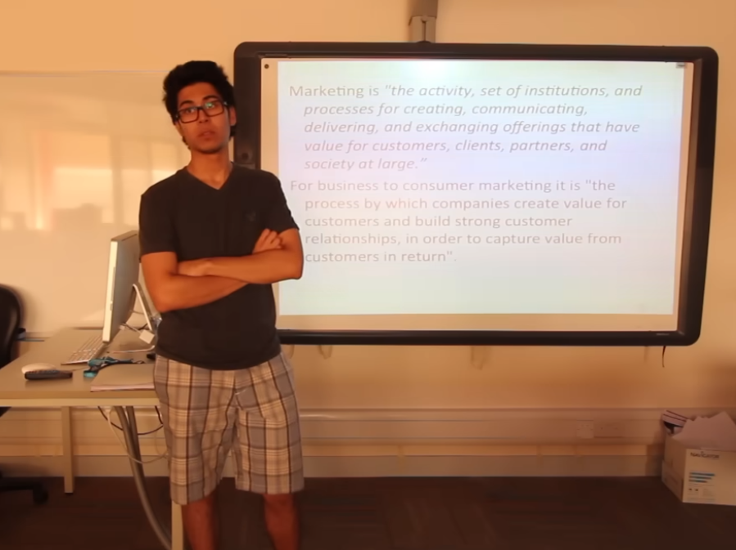
Good technique for delivering a presentation
Presentation Good/Bad Examples

Slide 32

Presentation Skills
Further Reading:
Skills Guide - The OCR Guide to Presentation Skills

Slide 33
Presentation Skills: References
Bongers, A. and Macartney, D. (2020) Principles of scientific communication. Available at: Principles of Scientific Communication – Simple Book Publishing (accessed 13th August 2025).
Hopkins, D. and Reid, T. (2024) The academic skills handbook. Your guide to success in writing, thinking and communicating at university (2nd edition). London: Sage.
Husain, S. (2012) Presentation Good/Bad Examples. Available at: Presentation Good/Bad Examples (accessed 9th September 2025).
Option Technologies. (2025) Effective presentations; Do’s and Don’ts. Available at: Effective Presentations; Do's and Don’ts (accessed 26th August 2025).
Roseland, W. (2017) A one minute TEDx talk for the digital age. Available at: A one minute TEDx Talk for the digital age | Woody Roseland | TEDxMileHigh (accessed 9th September 2025).
University of Bedfordshire. (2012) Delivering a Bad presentation – spot the mistakes. Available at: Delivering a bad presentation - spot the mistakes - YouTube (accessed 9th September 2025).

Slide 35

Using Communication Tools (PowerPoint)

Slide 36
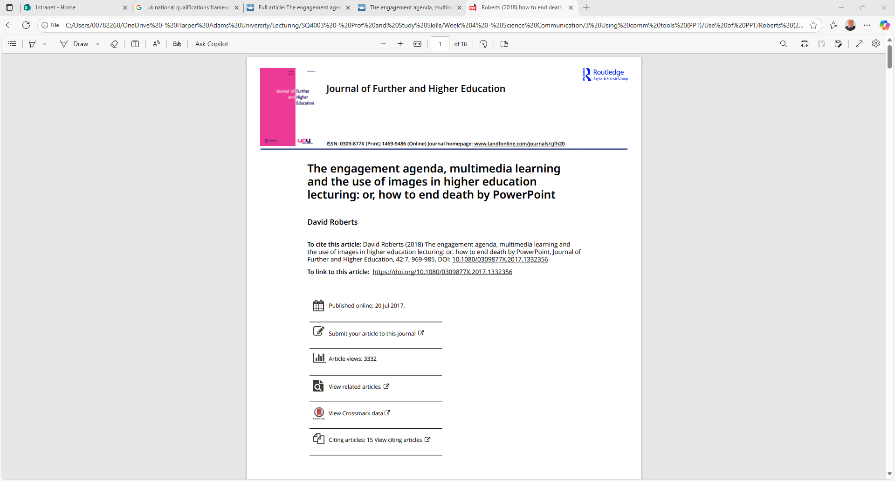
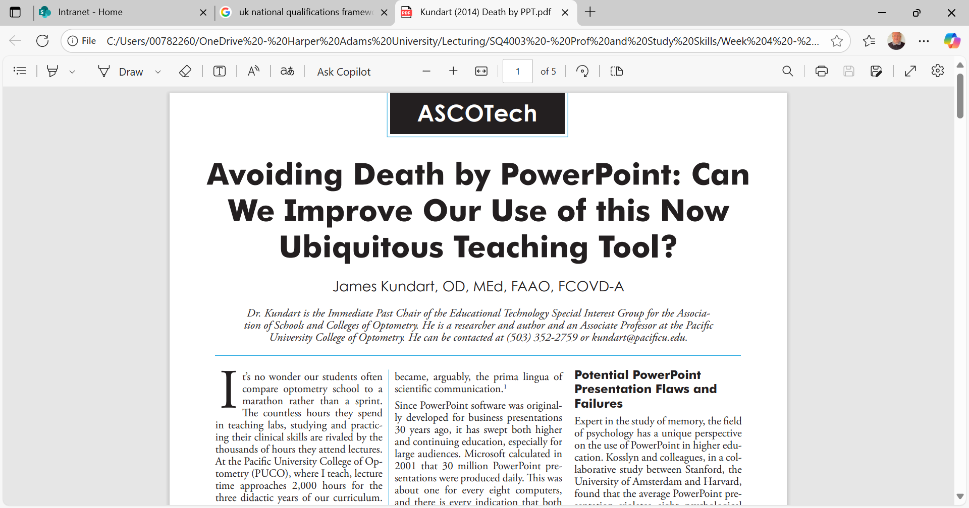
Using Communication Tools (PPT)
Why PowerPoint?

Slide 37
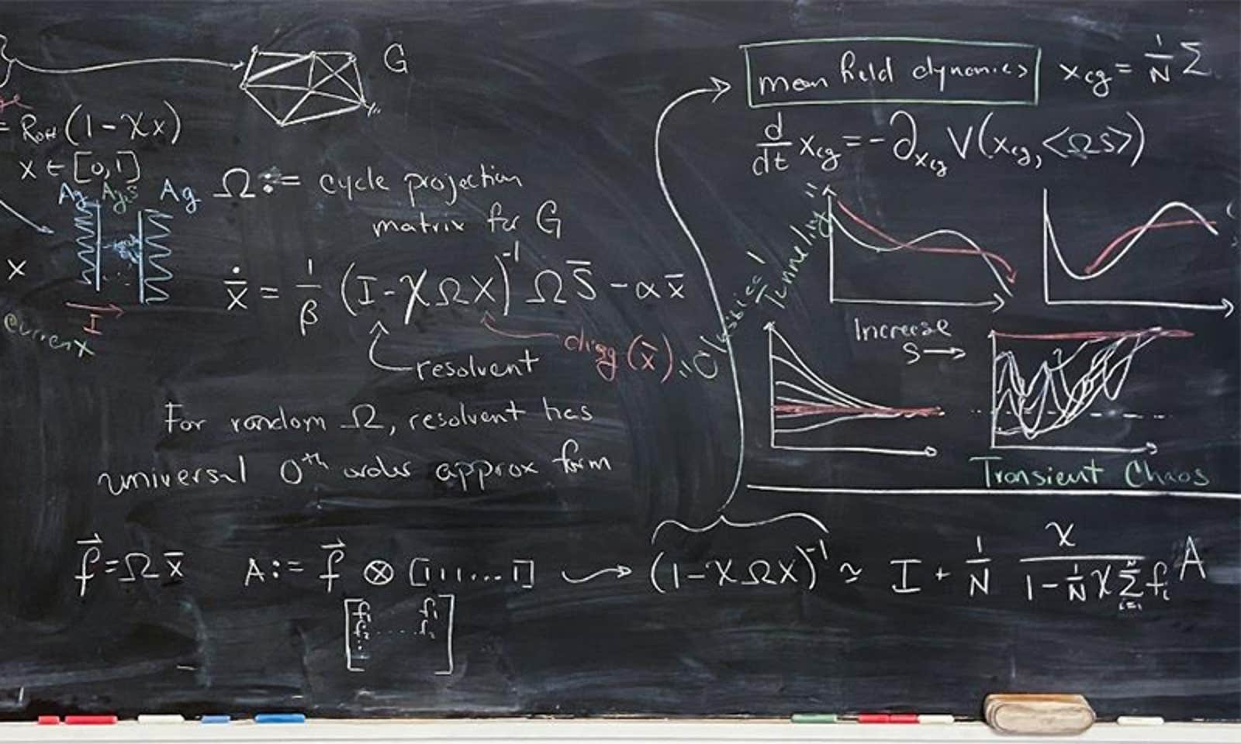
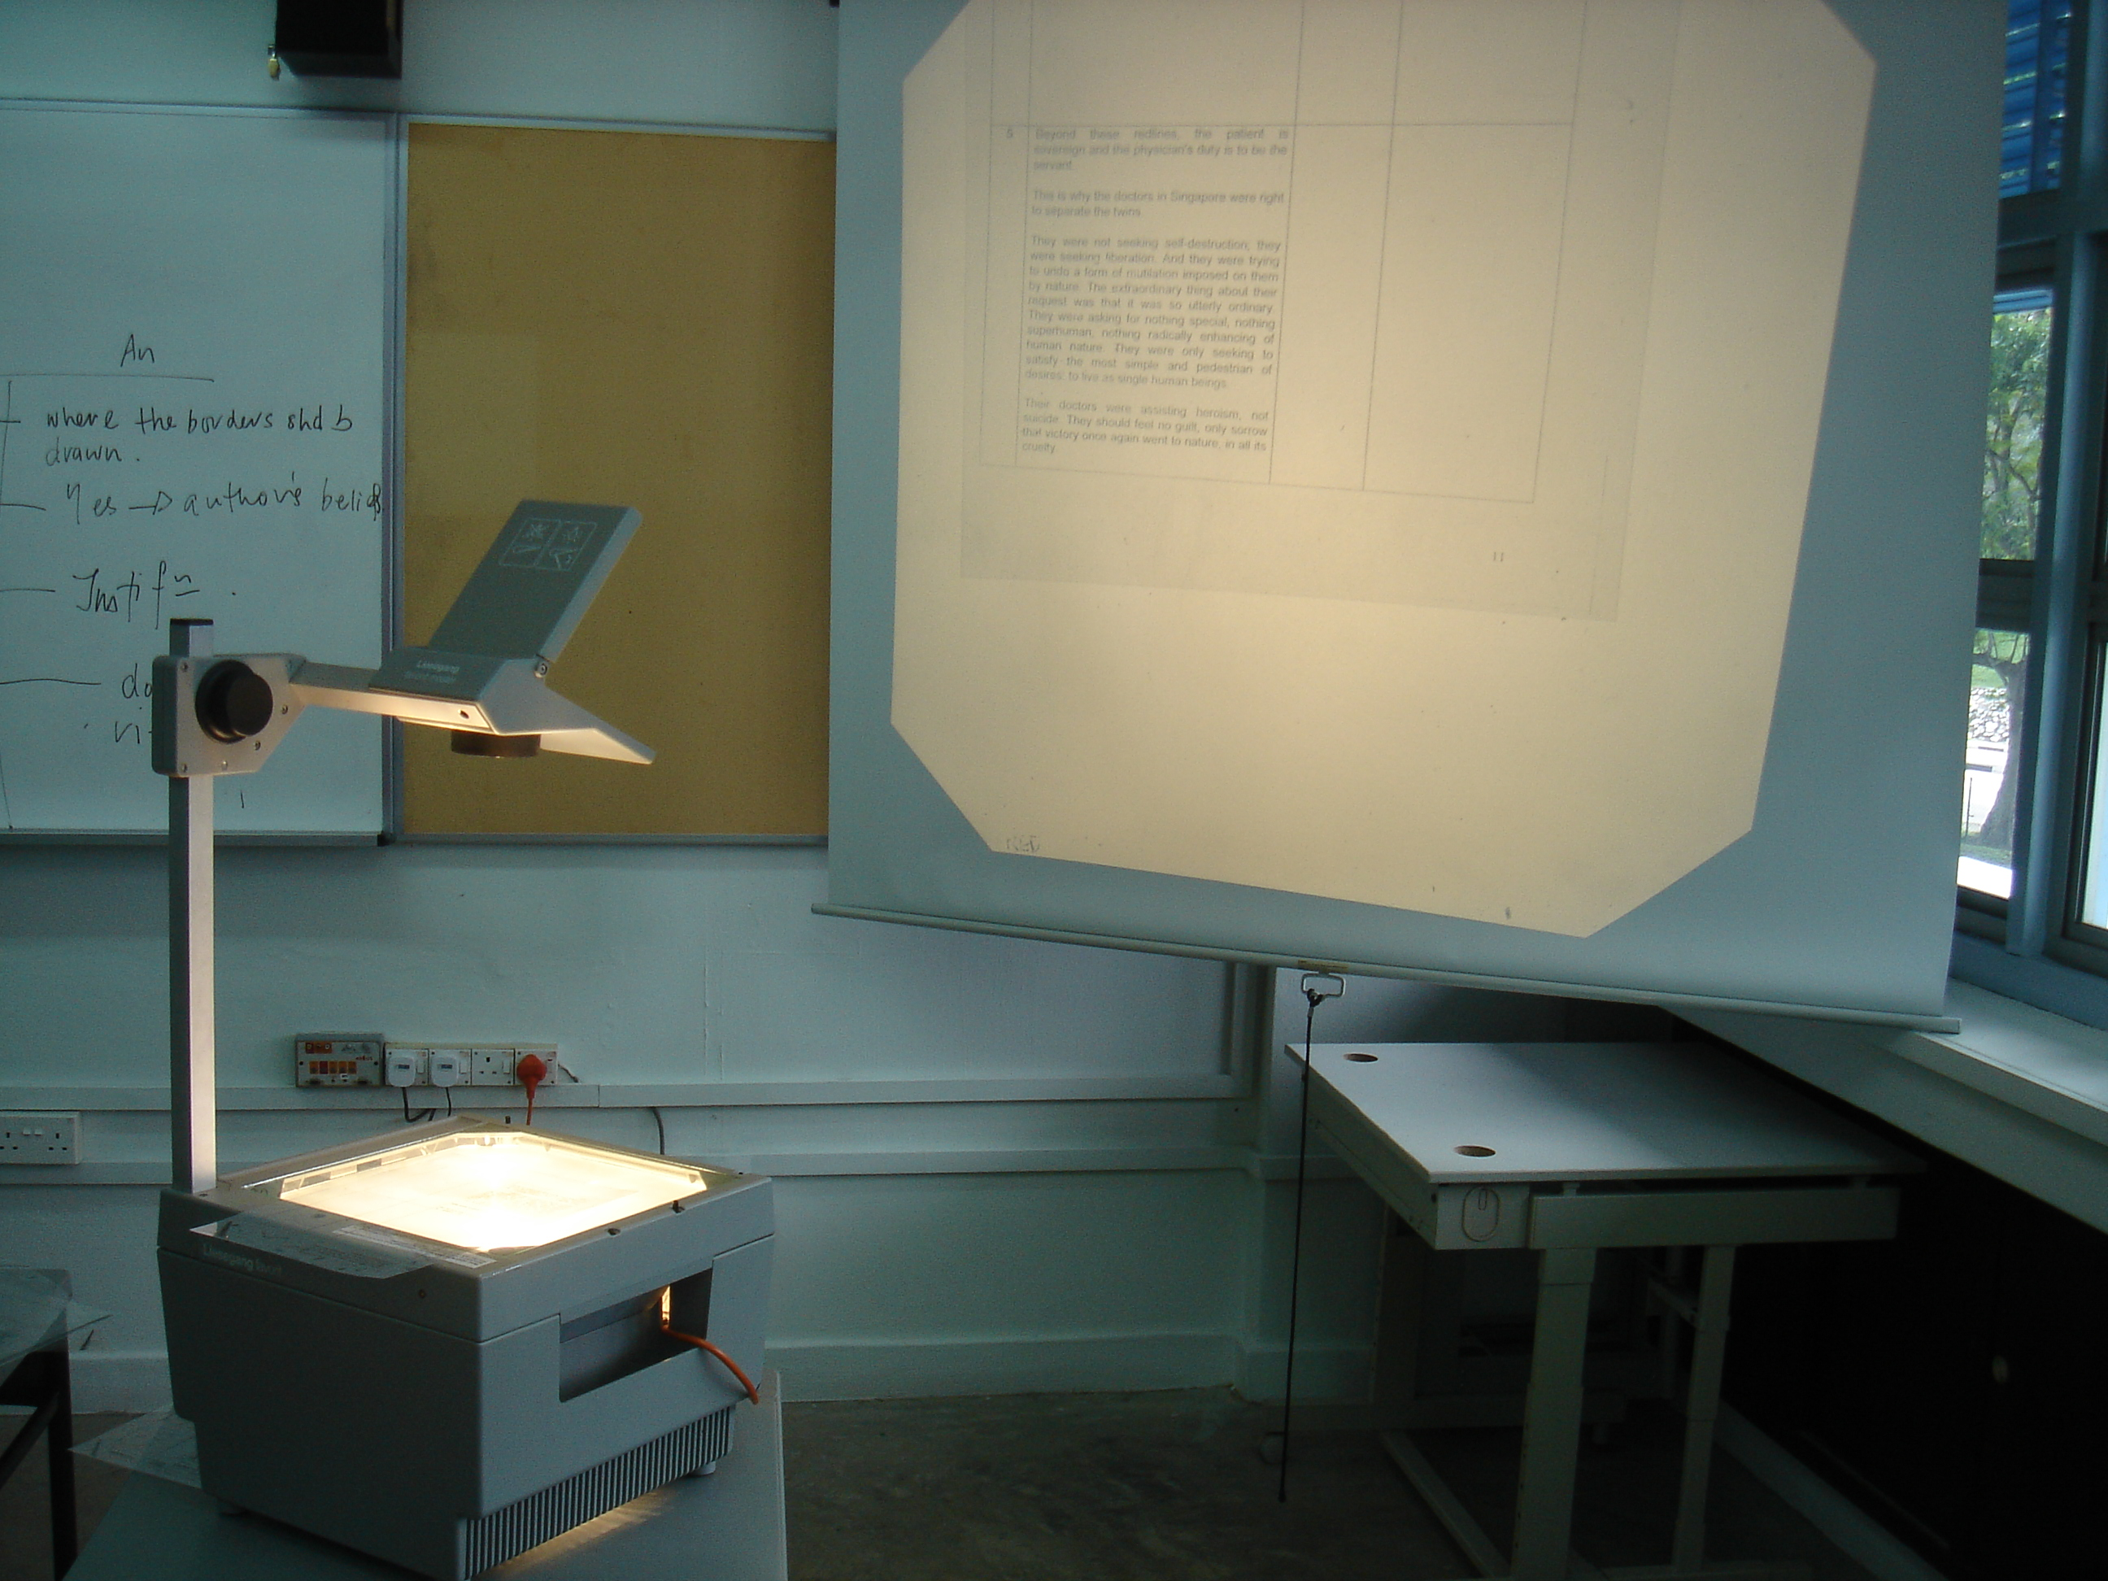

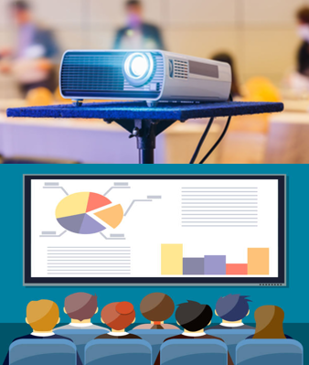
Using Communication Tools (PPT)
Why PowerPoint? The evolution of presenting tools

Slide 38
Using Communication Tools (PPT)
How have you used PowerPoint in the past?

Slide 39
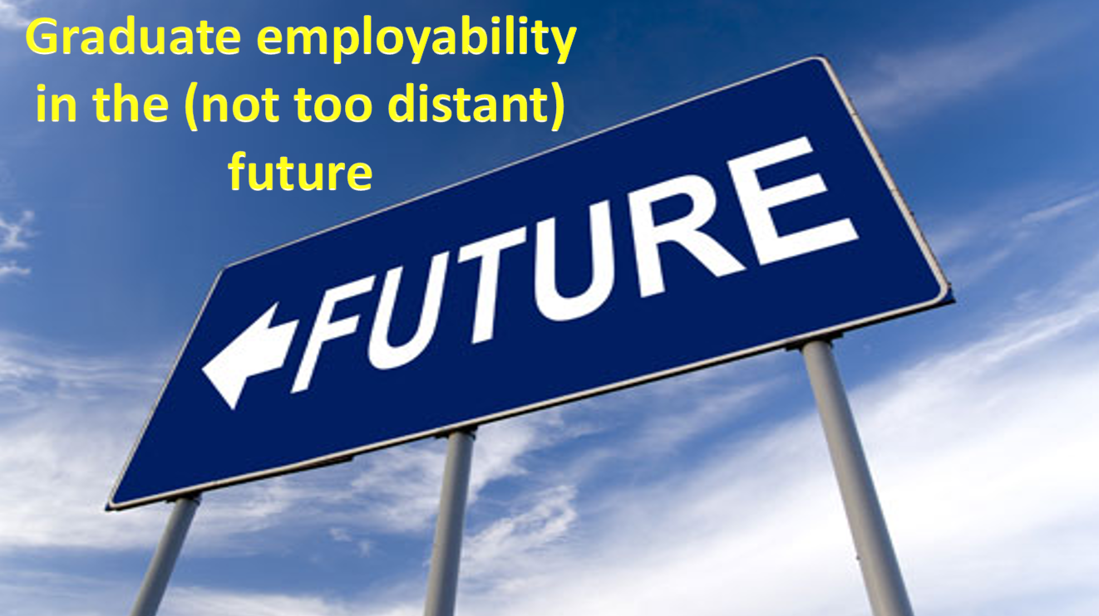
Using Communication Tools (PPT)
How have you used PowerPoint in the past?
I made a video!

Slide 40
Using Communication Tools (PPT)
PowerPoint presentations are a great way to support a speech, visualize complicated concepts or focus an audience’s attention.
However, a bad presentation can achieve the opposite. Poorly designed slides with too much text or distracting graphics can lead the audience away from your message
(TCNJ, 2024).

Slide 41
Student Quiz:
For the following slides, decide whether it is a good use of PowerPoint or a poor use of PowerPoint
- Be prepared to explain your judgements!

Slide 42
The core principles of data science involve the entire data lifecycle: defining business problems, acquiring and preparing data (cleaning, transforming), exploring and analyzing it (EDA), building and evaluating statistical and machine learning models, communicating insights through visualization, deploying and maintaining models, and crucially, adhering to ethical considerations like privacy and bias mitigation. These principles are underpinned by strong analytical thinking, domain knowledge, programming skills (like Python), and a commitment to continuous learning and ethical practices.
1. Problem Definition & Data Acquisition
Understand the Business Problem:
Begin by clearly defining the objective and identifying the specific business problem to be solved.
Data Acquisition:
Gather relevant data from various sources, such as databases, APIs, or real-time streams.
2. Data Preparation & Exploration
Data Cleaning: Handle missing, inconsistent, or erroneous data to ensure data quality.
Data Transformation: Normalize, encode, or scale data to make it suitable for modeling.
Exploratory Data Analysis (EDA): Use statistical analysis, visualizations, and other techniques to understand the data's structure, quality, and patterns.
3. Modeling & Evaluation
Model Selection:
Choose appropriate statistical and machine learning models (regression, classification, clustering) based on the problem type.
Model Training & Testing:
Train selected models on the prepared data and evaluate their performance.
Simplicity Over Complexity:
Start with simpler models and only add complexity if necessary to avoid overfitting and improve interpretability.
Bias Mitigation:
Apply techniques to address algorithmic bias in models and data to ensure fairness.
4. Communication & Deployment
Data Visualization:
Use charts, graphs, and dashboards to effectively communicate complex insights and findings to stakeholders.
Deployment & Integration:
Deploy trained models into production environments or integrate them into software systems.
Maintenance:
Continuously monitor and maintain deployed models to ensure ongoing performance.
5. Foundational & Ethical Principles
Analytical Thinking:
Apply statistical reasoning and hypothesis testing to extract meaningful information from data.
Domain Knowledge:
Integrate subject matter expertise to better understand the context and implications of the data and analysis.
Ethical Considerations:
Prioritize data privacy, security, transparency, and accountability, ensuring responsible data handling.
Continuous Learning:
Stay updated with the latest trends, tools, and techniques in the rapidly evolving field of data science.

Slide 43
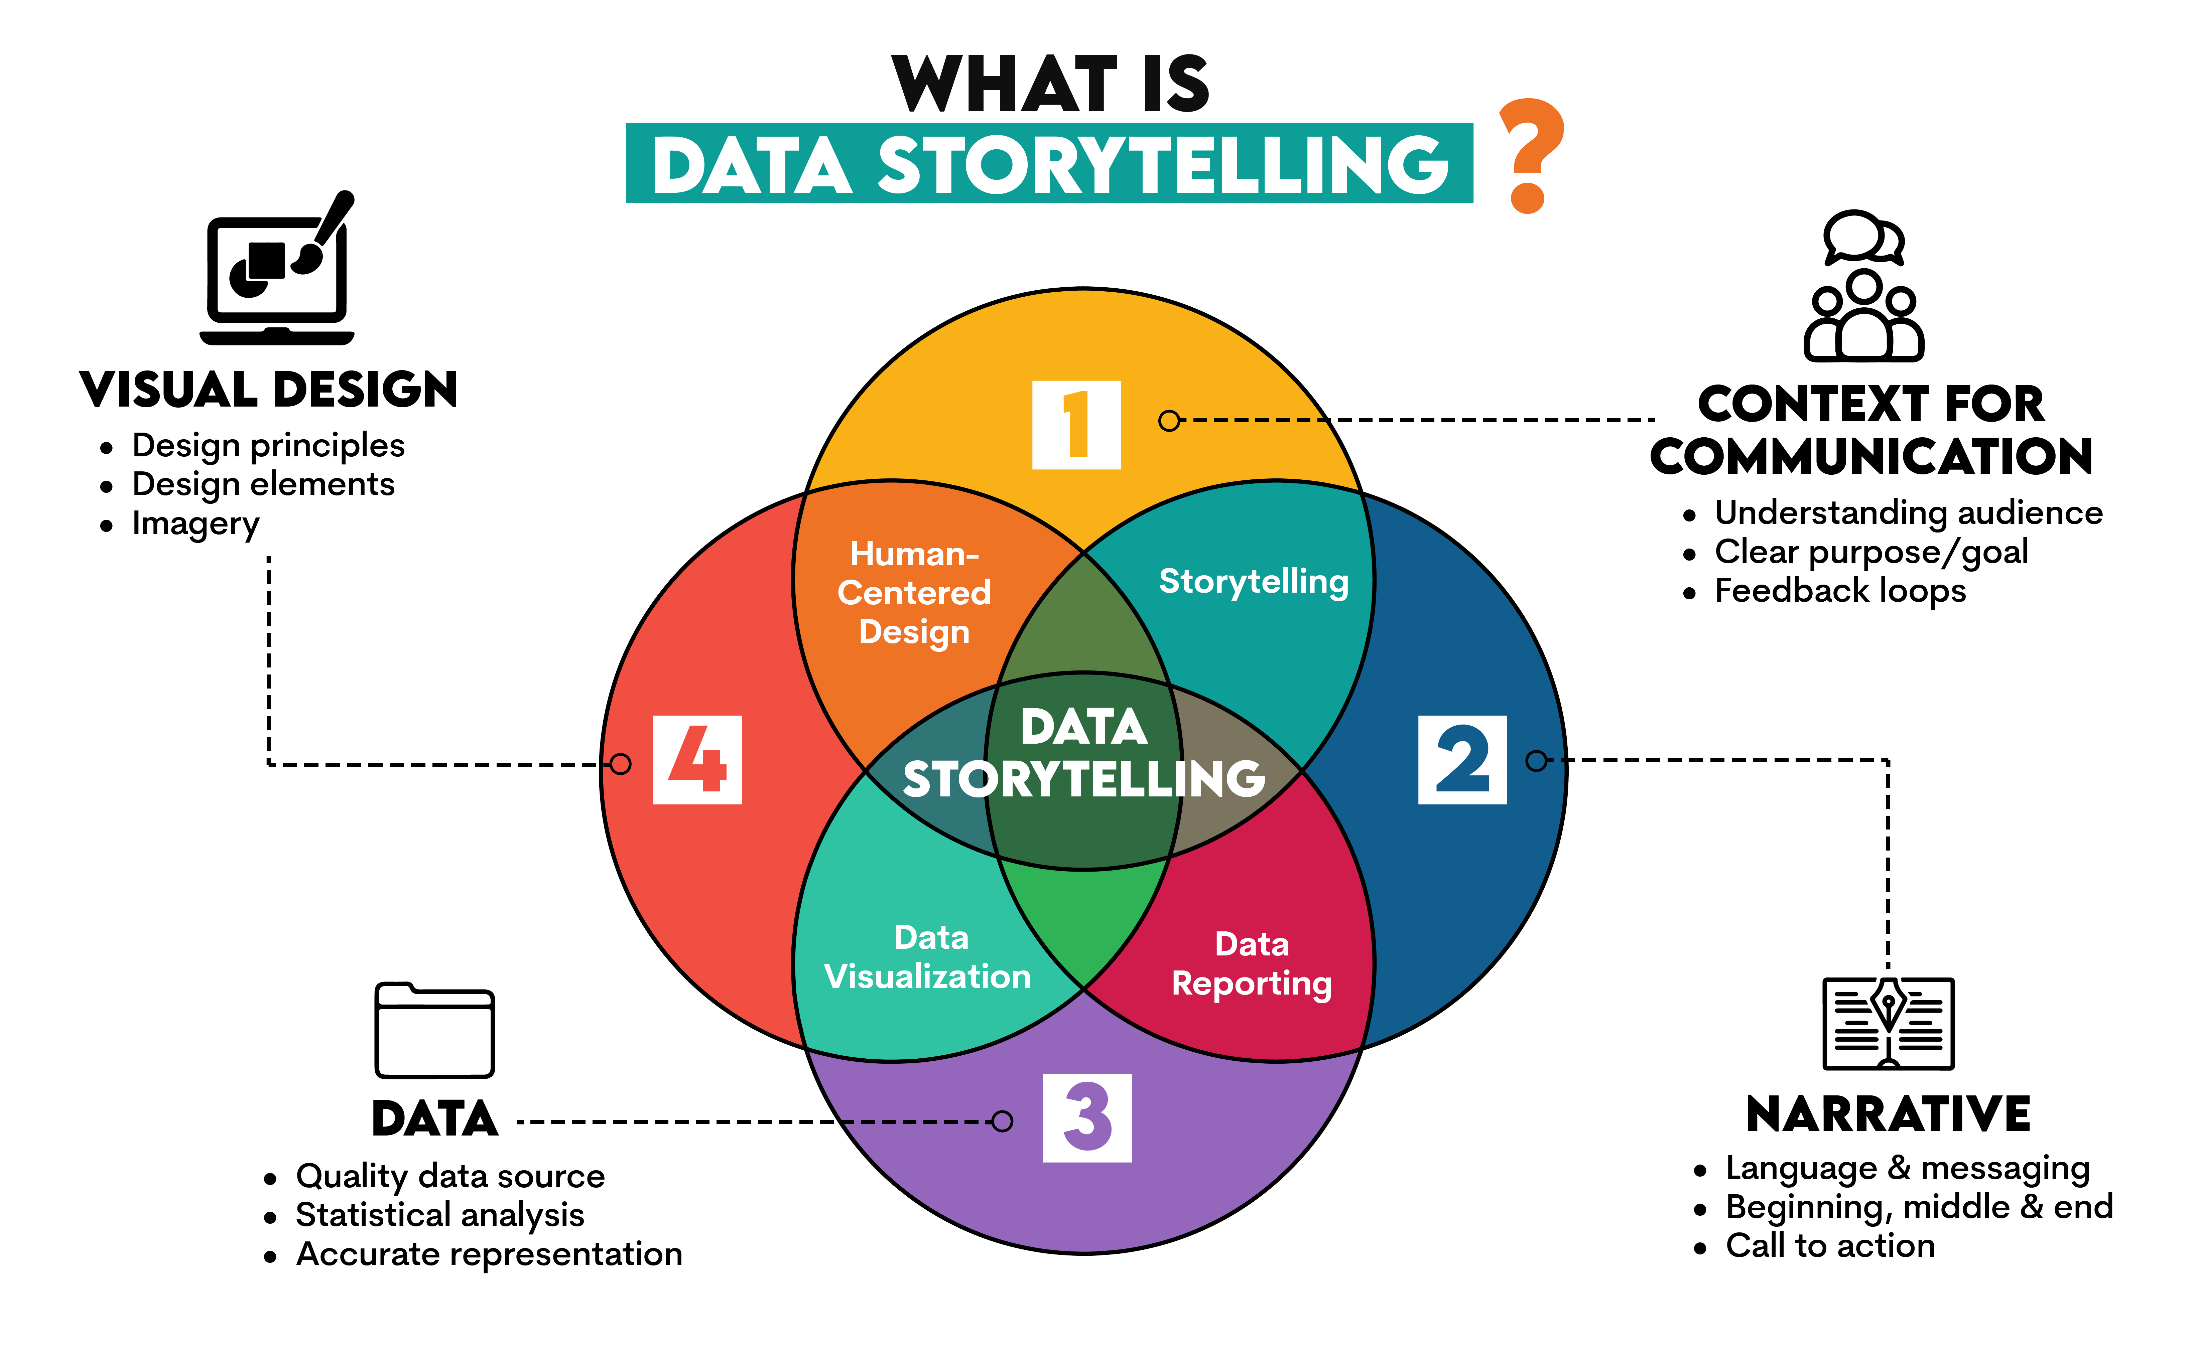

Slide 44
Robotics is an interdisciplinary field of engineering and computer science focused on the design, construction, operation, and application of robots. The primary goal of robotics is to create intelligent machines that can assist humans, often by performing tasks that are repetitive, dangerous, or otherwise undesirable for people.
Key components
For a machine to be considered a robot, it typically combines three fundamental elements:
Mechanical construction: The physical body or frame of the robot, which is built to carry out a specific task. This can range from humanoid forms to industrial arms or mobile vehicles.
Electrical components: The power source and control systems that activate the machinery, such as motors for movement and sensors for detecting the environment.
Software: The programming that tells the robot how and when to perform its tasks, which can range from simple remote controls to advanced artificial intelligence that allows for autonomous decision-making.

Slide 45
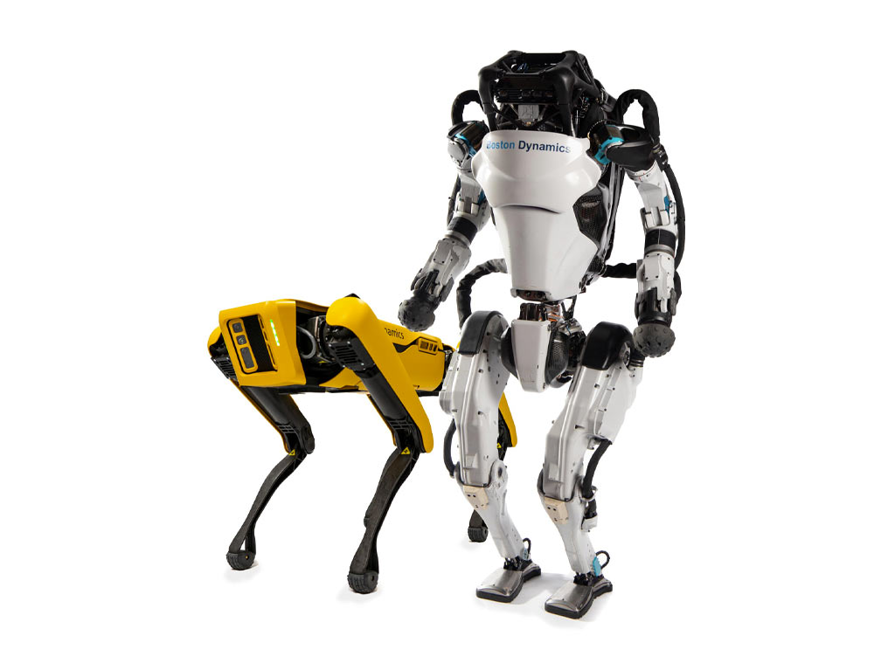

Slide 46
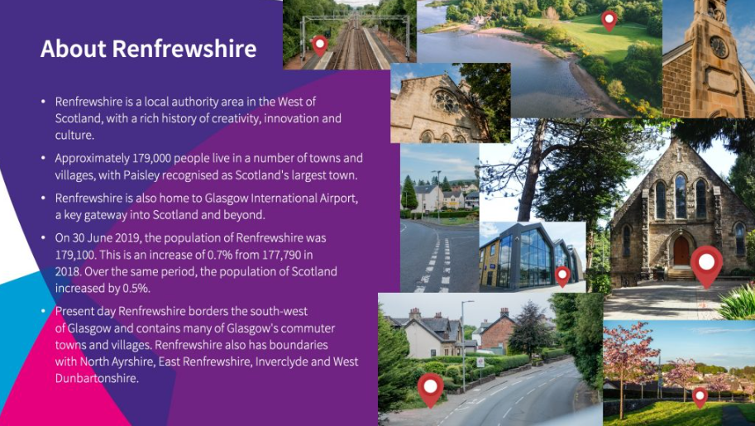
Notes:
An example of a busy PowerPoint slide

Slide 47
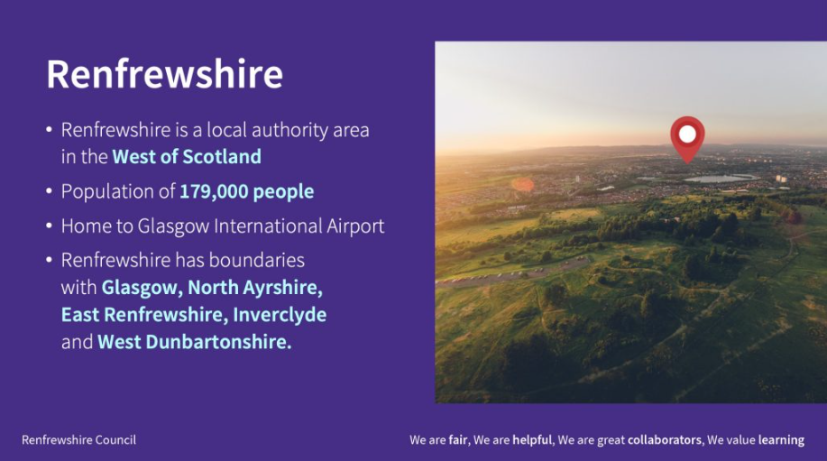
Notes:
An example of a simple PowerPoint slide

Slide 48
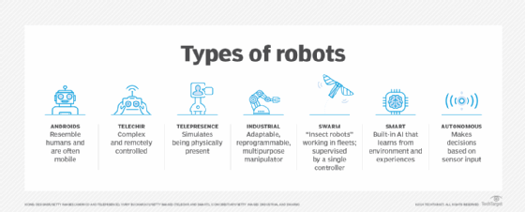

Slide 49

Defining Automation
Automation is the application of technology to perform tasks without human intervention. It involves using software, machines or systems to execute processes or workflows automatically. Automation can range from simple repetitive tasks to complex decision-making processes
(Infinity Group, 2025).

Slide 50
Defining Automation
Automation is the application of technology to perform tasks without human intervention. It involves using software, machines or systems to execute processes or workflows automatically. Automation can range from simple repetitive tasks to complex decision-making processes
(Infinity Group, 2025).

Slide 51
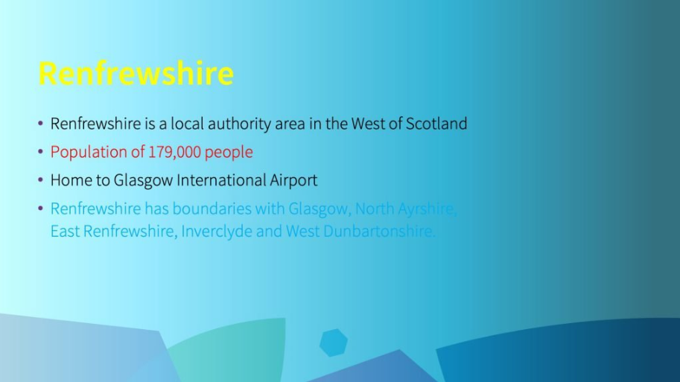
Notes:
An example of a slide with too many colours

Slide 52
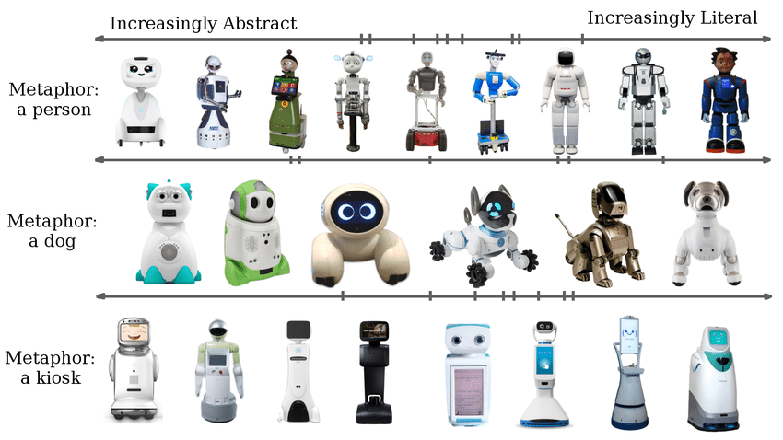
Robots can take a variety of different forms such as a human form, the form of an animal (e.g. dog) or the form of an object (e.g. kiosk / reception point).

Slide 53

Using Communication Tools (PPT)
Student Task:
Working in pairs,
based on your experiences as a student:
Create a checklist of Do’s and Don’ts for using PowerPoint as a communication / presentation tool.
Be prepared to share your responses!

Slide 54
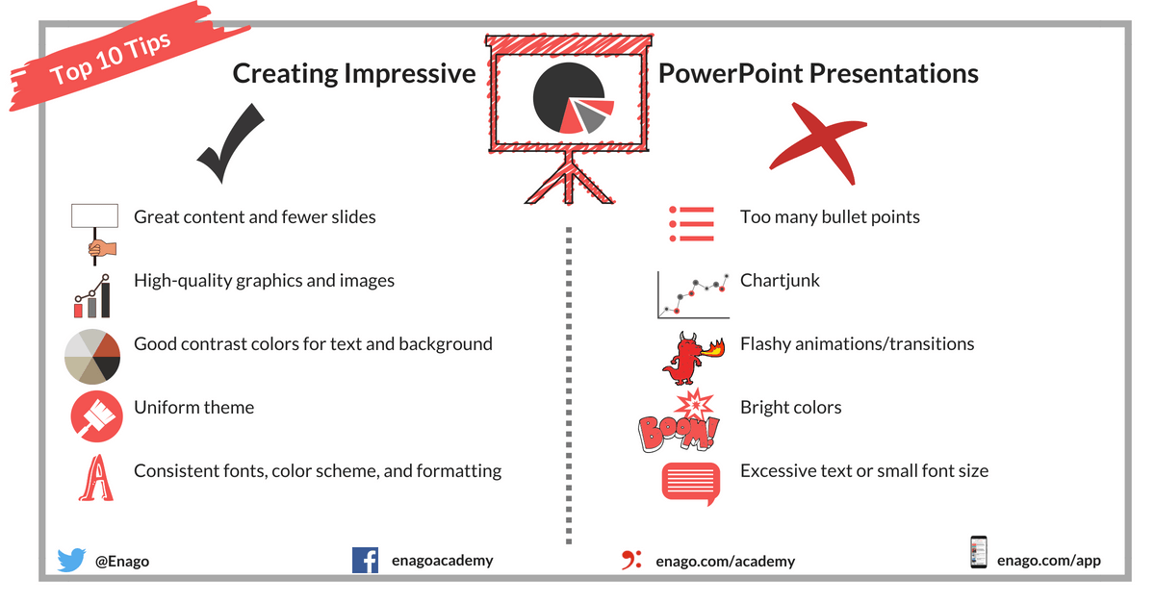
(Enago Academy, 2023)

Slide 55
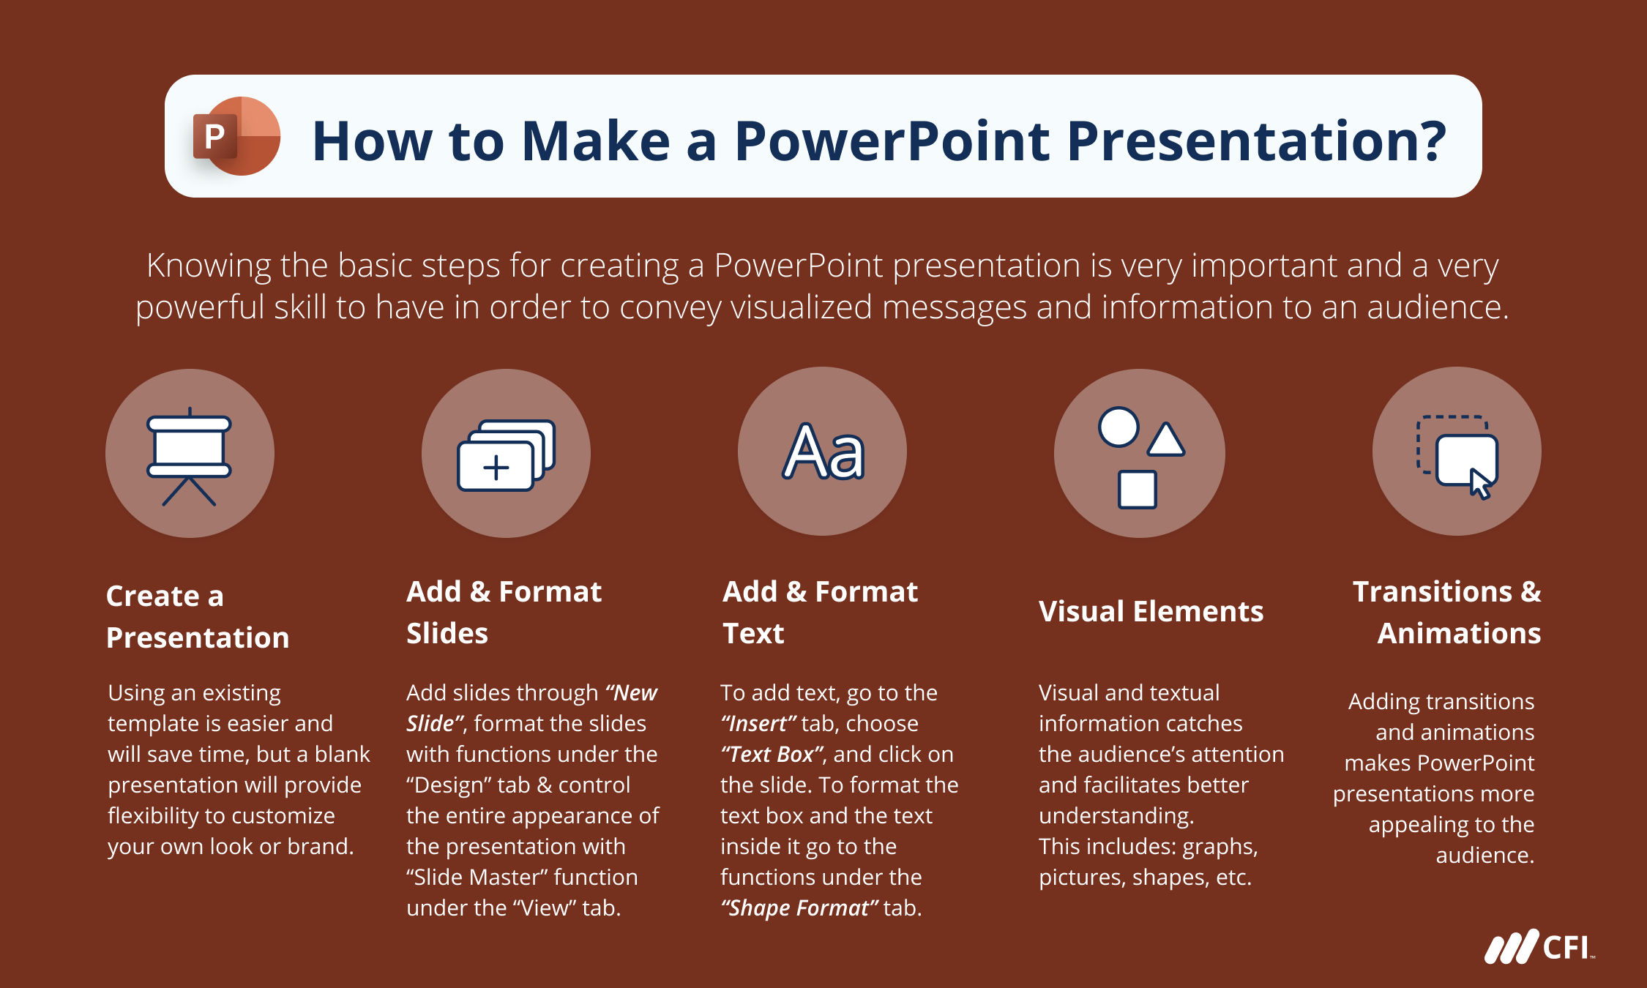

Slide 56
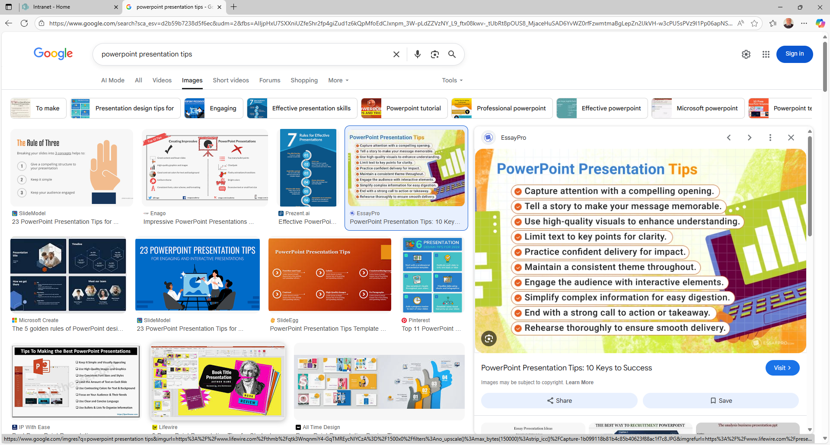

Slide 57
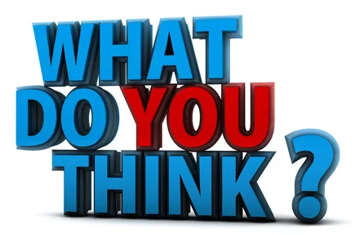
1.Create a simple design template.
2. Use appropriate font and size (and be consistent).
3. Use good quality images.
4. Avoid too many special effects.
5. Limit the number of slides.
6. Do not read from your slides or speak to them.
7. Have a clear structure.
8. Technical problems when using PowerPoint.
Read your handout ‘Tips for Designing’…
(Glynn, 2002; Hopkins and Reid, 2024; TCNJ, 2024)

Slide 58
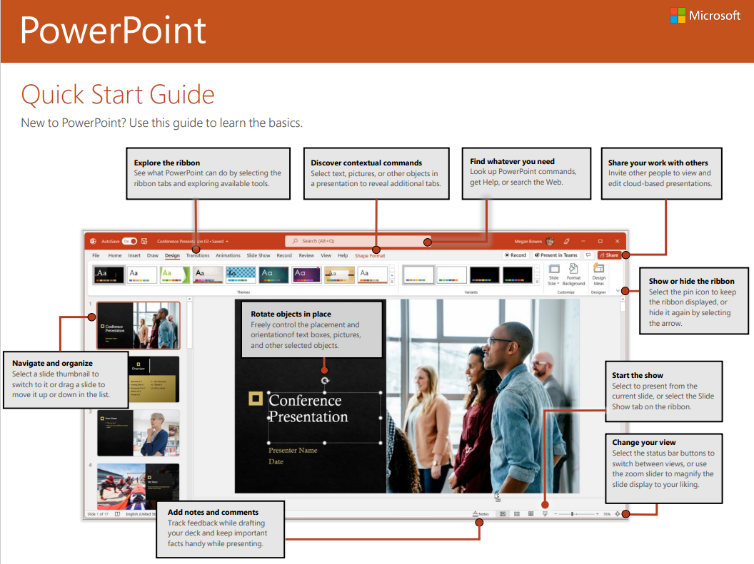
Using Communication Tools (PPT)
Further Reading:

Slide 59
Using Communication Tools (PPT) References
Enago Academy. (2023) Useful tips for creating impressive PowerPoint presentations. Available at: Useful Tips for Creating Impressive PowerPoint Presentations - Enago Academy (accessed 9th September 2025).
Glynn, D. (2022) 5 tips for designing better PowerPoint slides. Available at: 5 tips for designing better PowerPoint slides | The Thread (accessed 9th September 2025).
Hopkins, D. and Reid, T. (2024) The academic skills handbook. Your guide to success in writing, thinking and communicating at university (2nd edition). London: Sage.
Infinity Group (2025) Automation. Available at: What is Automation? - Infinity Group (UK) (accessed 9th September 2025).
Kundart, J. (2014) Avoiding death by PowerPoint: Can we improve our use of this now ubiquitous teaching tool? Optometric Education, 39 (3), pp.104-107.
Microsoft (2025) PowerPoint. Quick start guide. Available at: PowerPoint QS (1).pdf (accessed 13th August 2025).
Roberts, D. (2018) The engagement agenda, multimedia learning and the use of images in higher education lecturing: or, how to end death by PowerPoint. Journal of Further and Higher Education, 42 (7), pp.969-985.
The College of New Jersey (TCNJ) (2024) 7 Tips for Designing and Delivering PowerPoint Presentations. Available at: 7 Tips for Designing and Delivering PowerPoint Presentations | Media & Technology Support Services (accessed 9th September 2025).

